Slide 1
Grants Management System (GMS) Training Module 8
MODULE
8
Downloading Budgets to Excel
Uploading Budgets to GMS
Notes:
Module 8 explains how to upload and download budgets from Excel into GMS. This capability is NEW for FY21.

Slide 2
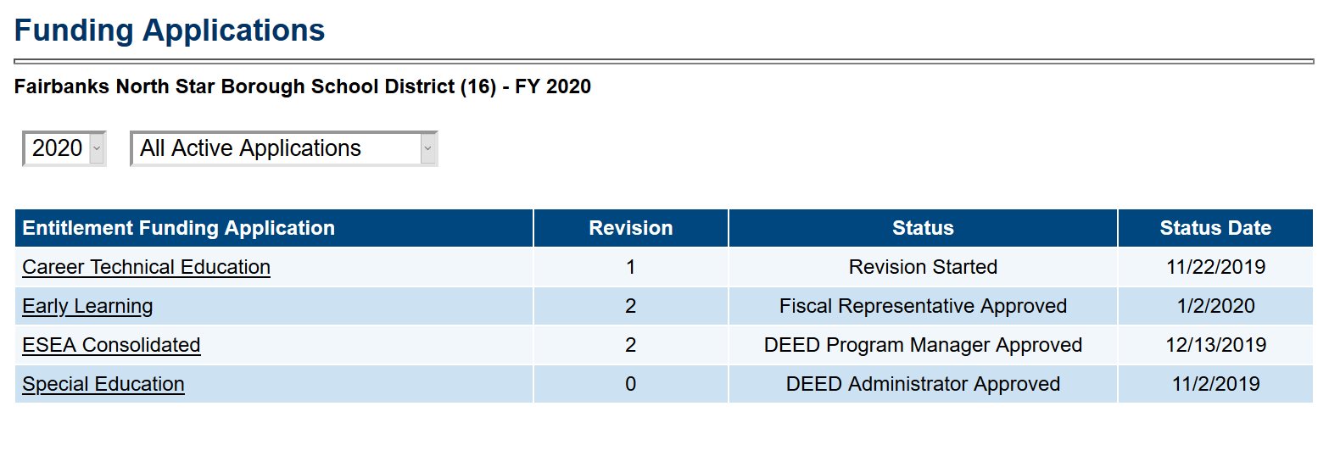
Review Last CLNA or Application
Choose year from the Drop Down Box
Choose Approved Applications
Click on the CTE funding Application
*Use this process to find old CLNA or Four-Year Plan and Local Application Documents
Notes:
Use the Funding Applications page to make sure you’ve reviewed the most recent CLNA and Four-Year Plan and Application before beginning a new application
Or to find an old one or check to see when a new one is due

Slide 3
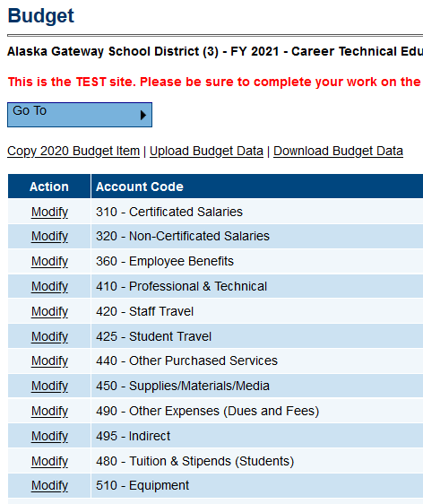
GMS Budget - NEW
Grant Must be in Draft Started or Revision Started Status
Options:
COPY (1x only – see Module 2 or below)
Work directly in GMS as usual
Use Excel to upload /download budgets
COPY – must be chosen before entering any budget info - 1st time or it will disappear
Notes:
Your grant will need to be in Draft Started or Revision Started in order to see MODIFY
UPLOAD/DOWNLOAD – uses EXCEL

Slide 4
Why Use Download/Upload?
Facilitate faster data entry
View more budget details at one time
Print budgets from Excel
Use Excel functions (graphs, equations, etc.)
Schools can send budgets for district consolidation
Download/print filtered data (detail – tags)
Notes:
This is a new capability in the FY21 grants. It will not be available for older/closed grant years

Slide 5
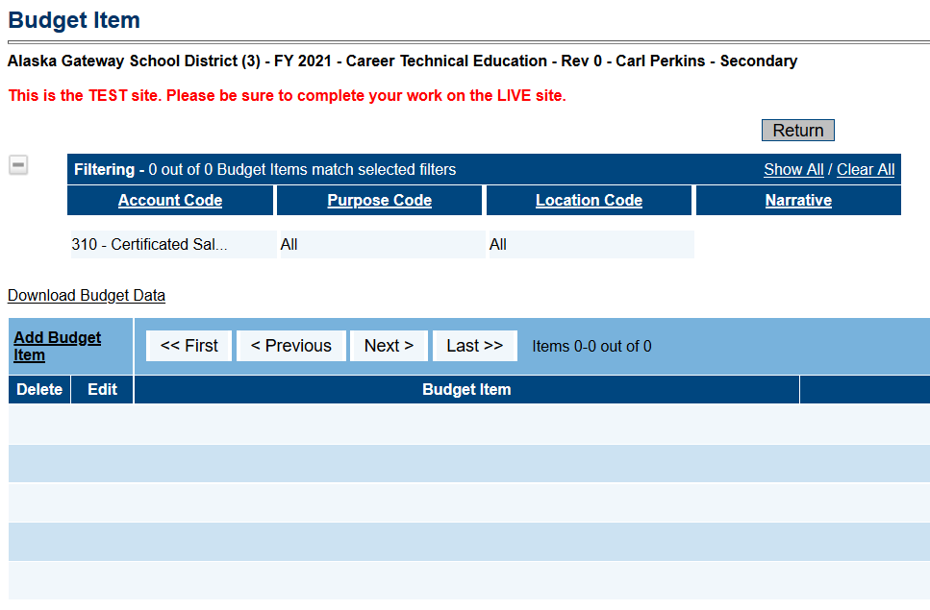
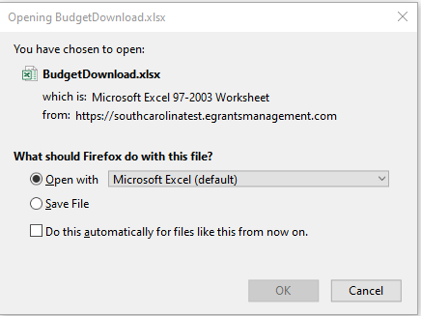
Download
Anyone who has roles to VIEW may DOWNLOAD, in ANY status
Public may download APPROVED versions only
Notes:
Select Download – Popup – mine says ‘may be corrupted’ after this –
May Download all or filtered budget.
Anyone who can VIEW can DOWNLOAD, in any STATUS
Includes Public – Approved versions ONLY

Slide 6
Budget Download
CRITICAL: Do NOT alter or delete any column headers! See slide notes for details -
Upload/
Download
Reference – Cut/Paste
Notes:
Downloaded budget will open in Excel and look like this.
You may ADD columns – for example a “Notes” column at the end. GMS will not read this column
You can MOVE columns – for example you could put the Organization Code at the end
YOU MAY NOT delete any of the columns! This will result in an error and you will not be able to upload the budget
YOU MAY NOT change the headers in Row 1. This will result in an error, and you will not be able to upload the budget

Slide 7
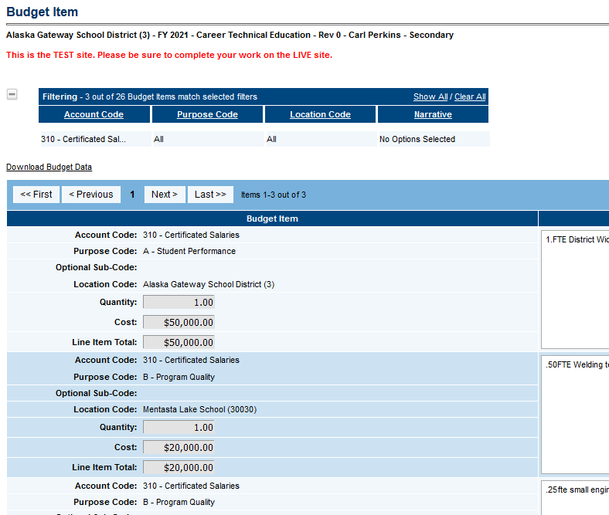
Budget Download – Two Options
Downloads from main Budget page will contain all items AND indirect
Downloads from Budget Item detail/filtering page will only contain detailed items and NO indirect

Slide 8
Upload – Step 1
Download – ensures most recent budget
Modify using Excel tabs “Available” info
Update/Delete/Create in each row
STRIP OUT all Indirect rows
Notes:
First, download the last approved budget, so you are working in the most recent one.
Next, modify information in the tabs as needed. Remember that you can’t change the column headers.
For each tab, add or delete rows using cut and paste just like you would in any Excel spreadsheet
Make sure the ACTION column has the correct language – Update, Delete, or Create – no other words are allowed
Delete all the ‘old’ indirect rows, they will recalculate
Don’t forget if you are REVISING a budget item to add a DATE and a NOTE at the end of the NARRATIVE cell

Slide 9
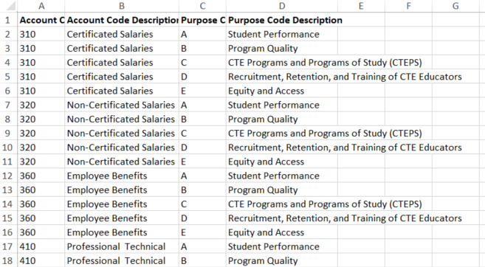
Available Budget Cells Tab
Purpose Codes A-E repeated for each Account Code
For reference and Cut/Paste into the “Budget Data” page
These items must NOT be altered – cut/paste as is
Notes:
List of allowable Object/Function combinations for the grant
For REFERENCE ONLY and can be used to copy and paste information to the data worksheet

Slide 10
Available Budget Tags Tab
CTE - IGNORE THIS TAB!
These tags are additional tags that other grants (Migrant, Title IA, etc.) are using
Notes:
CTE is doing “TAGS” at the purpose code level, because ours are simple.
Other grants will have TAG level.
Ignore this tab for CTE

Slide 11
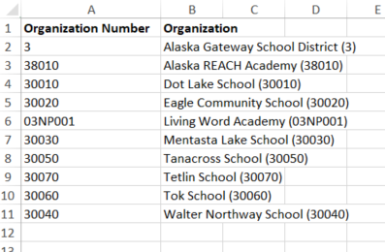
Available Organizations Tab
Each Budget Item must have either district or school selected on the ‘Budget Data’ tab. They can be copied from here.
Notes:
Organization must be selected at the district level, larger districts could also use school level for school – budgets sent in, or to track expenditures by school.

Slide 12
Upload – Step 2
Remember – Each “Created” Upload Data File remains “In Line” until it is deleted, modified, or the upload is completed
Notes:
Added a line using cut and paste from Available Budget Cells and Available Organizations

Slide 13
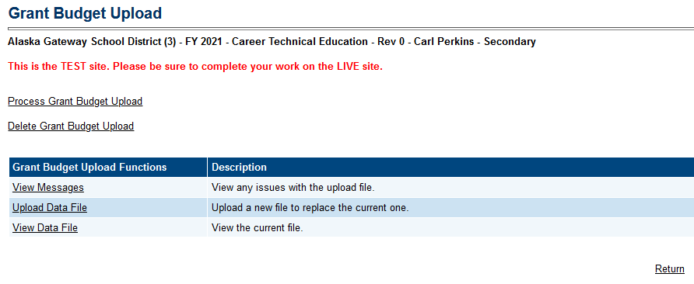
Upload – Step 3
VIEW Messages!!
View Data File
Delete or Process Upload – Remember each upload is ‘in line’ until deleted, viewed and modified, or processed
Notes:
ALWAYS click on View Messages FIRST!

Slide 14
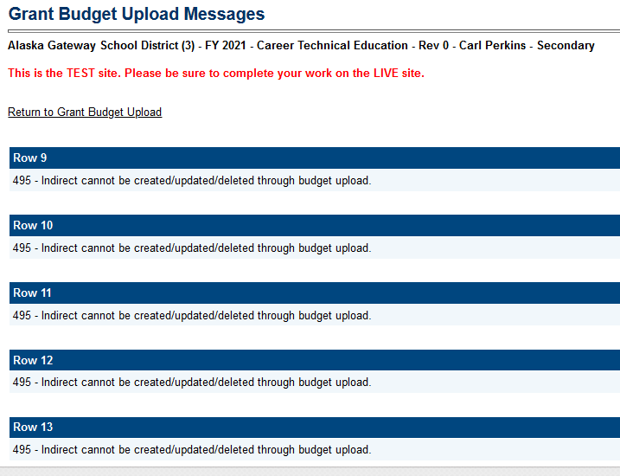
Upload – Errors
If there are ERRORS –
Return to Grant Budget Upload and either:
View Data File – then modify your file
OR
Delete Grant Budget Upload and modify your saved file, then re-upload
Notes:
Remember that RED ERRORS must be fixed

Slide 15
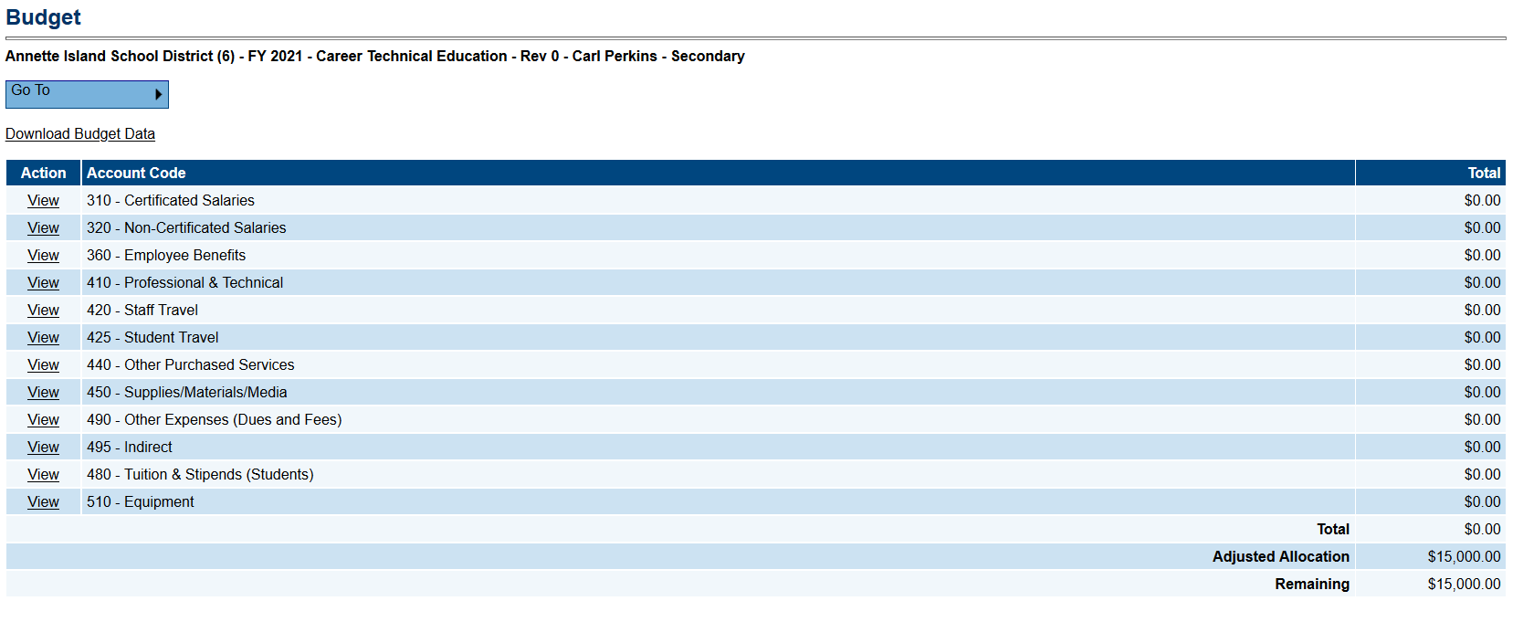
Upload – Complete
Notes:
When a processed upload is accepted, GMS will simply show the updated Budget page

Slide 16
Upload DON’TS
Don’t Delete/Modify Column Headers!
Don’t ‘retry’ to upload (1 at a time)!
Don’t Ignore ‘Messages’ – Always Check!
Don’t Forget ‘Action’ Column –
Update, Delete, or Create!

Slide 17
Tips
Download a NEW budget template for each new budget/revision –ensures most current data
May re-order or ADD columns, but – CRITICAL that text of column headings remain EXACTLY as downloaded
Required columns may NOT be deleted

Slide 18
TIPS, Continued
May add columns, BUT they will be ignored during upload (i.e. district ‘notes’ column)
Deleting – use “Delete” in the Action Column to delete a budget item
For REVISIONS – add a DATE and NOTE at the end of the NARRATIVE cell
Possible to upload entire budget or only one or a group of budget details (i.e. supplies budgets from each school)

Slide 19
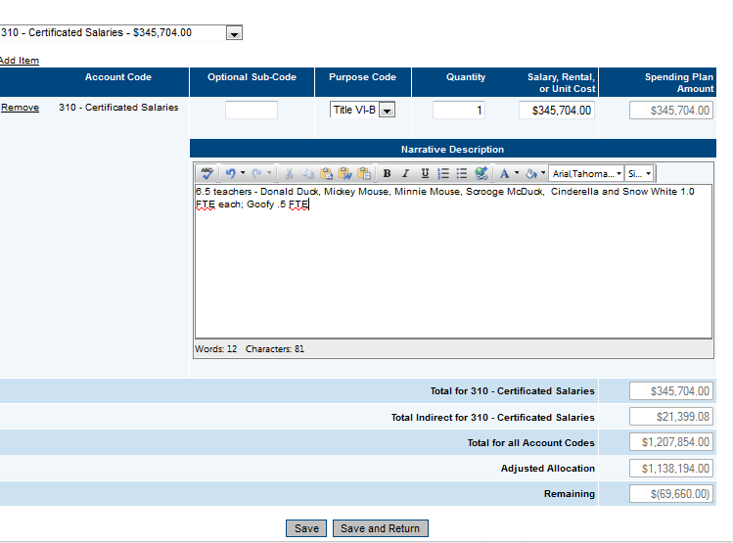
Budget Revisions
Don’t Forget!!
REVISIONS:
Date of change
Reason for change
(Add these at the end of the Narrative cell if you are using download/upload)
Notes:
Revisions – please DATE and say why – new supplies should be listed if supply line increases, if a training is cancelled and professional development funds are moved elsewhere, etc.

Slide 20
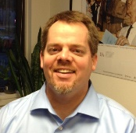
DEED/CTE Team
Deborah Riddle
Division Operations Manager, Innovation & Education Excellence
907-465-2892
deborah.riddle@alaska.gov
Brad Billings
Administrator, Career and Technical Education
907-465-8720
brad.billings@alaska.gov
GMS Specialist
Sheila Box
CTE Program Specialist
907-465-8704
sheila.box@alaska.gov
Felicia Swanson
Education Associate
907-465-2980
felicia.swanson@alaska.gov
Bjørn Wolter
CTE Program Specialist
907-465-6542
Bjorn.wolter@Alaska.gov
Notes:
This is the CTE Team.
Contact any of us with CTE questions
Sheila is the GMS specialist on the team – call her with questions specific to GMS

