Slide 1
Grants Management System (GMS)
Training Module 5
MODULE
5
Validations – Warning/Error
Print/Save
Grant Awards
Notes:
Module 5 covers some of the functions of the sections page, including viewing validations, and printing or saving an application to another file. The location of grant awards is also covered.

Slide 2
Validations and Printing
Sections Page – far right two columns are Validation and Print
Rows (left):
All (top row) – shows validations or ‘prints’ the entire application
Bold row headers with sign – process that section only
Underlined Page Names – process that page only
Notes:
Sections Page – far right two columns are Validation and Print
Rows (left):
All (top row): validates/prints entire application
Bold row headers with - symbol: validate/prints section only
Underlined Page Names: validates/prints page only

Slide 3
Validation Messages
Validation Messages – select All validation messages, list pops up
Dark blue bar = a page, all validations on that page listed underneath
Error messages: Stop the process
Must be fixed before application/revision can be completed
Warning messages: are for your information
Do not stop the process
Select Review on the left to go directly to the page error
Notes:
GMS has many behind the scenes validations to ensure application quality. Some are Warnings, and the application/draft can be completed without fixing them. Some are Errors, and GMS will not allow an application or draft to be completed until these are corrected.

Slide 4
Print Select Pages
Print Select Items – from Sections Page
Check box “Select Items” at the top of the print column
You may now select specific pages to PDF/Print using the boxes
Use Print function to:
Create a PDF of the Grantee Checklist
Save PDFs of Applications or budgets to internal district files
Notes:
Print functions may take a few minutes to process if they are large.

Slide 5
Print Request
Once a Print Request is selected, option page will open
All Print Requests produce a PDF for saving or printing
A short Print Request: opens on the screen as a PDF
A long Print Request: goes into the Document Library, at the top
Select the Print button on this page to begin the print function

Slide 6
Document Library Print Requests
Open the Document Library
Top of screen: the Print Request will appear, including:
Print Request Name – underlined, so selectable
Date of request
Expiration date of request
You may select and open, or delete this print request
Print requests expire after 7 days

Slide 7
Grant Awards
DEED now stores the district’s grant awards in GMS
From the Sections Page
Bottom page is Grant Award Report – select this link to view/save/print awards

Slide 8
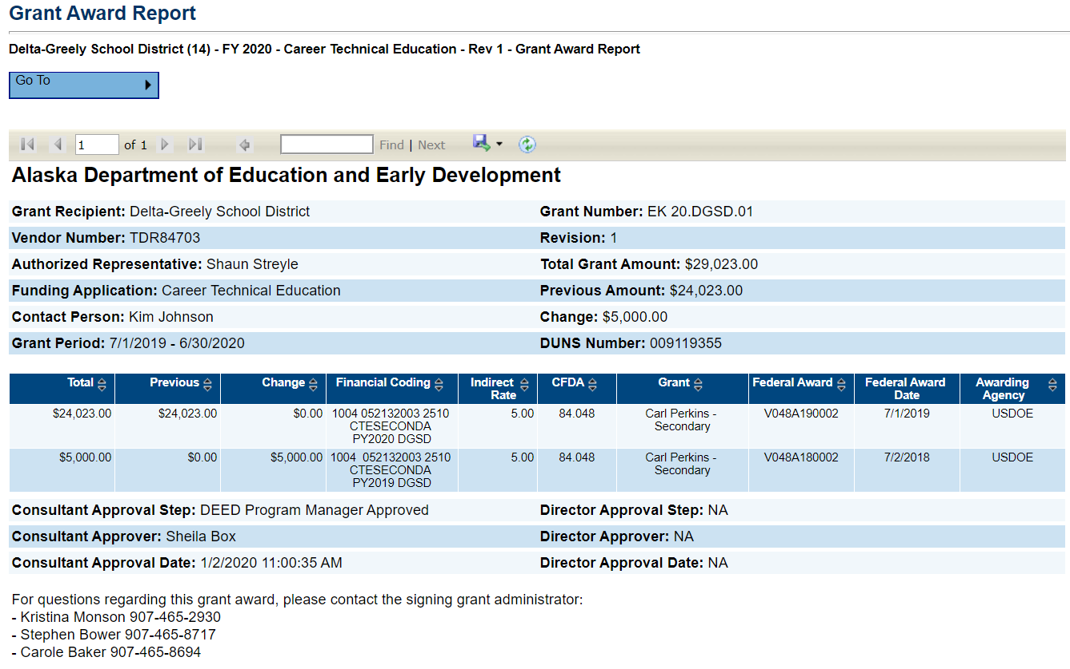
Grant Award Report
Multiple Awards will show on separate pages
Grant Award Reports may be exported to local files using the disc icon

Slide 9
DEED/CTE Team
Deborah Riddle
Division Operations Manager, Innovation & Education Excellence
907-465-2892
deborah.riddle@alaska.gov
Brad Billings
Administrator, Career and Technical Education
907-465-8720
brad.billings@alaska.gov
GMS Specialist
Sheila Box
CTE Program Specialist
907-465-8704
sheila.box@alaska.gov
Felicia Swanson
Education Associate
907-465-2980
felicia.swanson@alaska.gov
Bjørn Wolter
CTE Program Specialist
907-465-6542
Bjorn.wolter@Alaska.gov
Notes:
This is the CTE staff.
Contact any of us with CTE questions
Sheila is the GMS specialist on the team – call her with questions specific to GMS

