Slide 1
McKinney-Vento Program Funding
An Excellent Education for Every Student Every Day
Alaska Department of Education and Early Development
April 2025
1
An Excellent Education for Every Student Every Day

Slide 2
Funding
Agenda
Title I-A Homeless Set-aside
McKinney-Vento Subgrant

Slide 3
Title I, Part A
Title I, Part A of the Elementary and Secondary Education Act, as amended by the Every Student Succeeds Act (ESSA) –
Provides financial assistance through State Education Agencies (SEAs) to Local Education Agencies (LEAs) and schools with high percentages of low- income children to help ensure that they all meet challenging state academic standards.
Includes specific requirements for collaboration with McKinney-Vento programs to serve homeless children and youth.

Slide 4
Legislation
Read the full text of
the Elementary and Secondary Education Act, as amended by the Every Student Succeeds Act (ESSA).

Slide 5
Regulations & Guidance
Read Education for Homeless Children and Youths | U.S. Department of Education from the U.S. Department of Education.
Download the U.S. Department of Education’s Letter for ESSA Title IA LEA Homeless Set-Aside (PDF) (ed.gov) (July 2018)
Download the Education for Homeless Children and Youths Program Non- Regulatory Guidance (pdf) (see Section M on Coordination with Title I, Part A of the ESEA)
Download Serving Preschool Children Through Title I, Part A of the Elementary and Secondary Education Act of 1965, as Amended. (February 26, 2024)

Slide 6
Title I-A Set-aside
The Elementary and Secondary Education Act (ESEA), as amended by the Every Student Succeeds Act (ESSA) –
Requires a Local Education Agency (LEA) to reserve Title I funds necessary to provide educationally related support services to homeless children and youths regardless of whether they attend a Title I school and to provide for their unique needs. Local educational agencies (LEAs), whether they have identified many or few homeless students, often struggle to determine an appropriate Title I, Part A homeless set aside amount.
The Education for Homeless Children and Youths Program Non-Regulatory Guidance suggests the following for determining the amount of funds to reserve for comparable services under Title I, Part A:
Funds reserved for comparable services under section 1113(c)(3)(A)(i) of the ESEA may be determined based on a needs assessment of homeless children and youths in the LEA, taking into consideration the number of homeless children and youths identified by the LEA and their unique needs. (ED, 2017, p. 41)

Slide 7
Title I-A Set-aside
Two principals govern the use of Title I, Part A funds
1 2
First, the services must be reasonable and necessary to assist homeless students to take advantage of educational opportunities. (ESEA section 1113(c)(3)(A); 2 CFR § 200.403(a)).
Second, Title I, Part A funds must be used only as a last resort when funds or services are not available from other public or private sources, such as the USDA’s National School Lunch Program and Breakfast Program, public health clinics, or local discretionary funds (sometimes provided by the PTA) used to provide similar services for economically disadvantaged students generally. (See ESEA section 1115(e)(2)).

Slide 8
Title I-A Set-aside Eligibility
Are homeless children and youths who attend non-Title I schools eligible to receive Title I, Part A services?
Yes. Under section 1113(c)(3)(A) of the ESEA, an LEA must reserve sufficient Title I funds to provide services to homeless students who attend non-Title I schools that are comparable to those provided to students in Title I schools.
These services may include providing educationally related support services to children in shelters and other locations where homeless children live. Services should be provided to assist homeless students to effectively take advantage of educational opportunities.
In addition to serving homeless children and youths who attend non-Title I schools, the homeless set-aside may be used to provide services to homeless students in Title I schools that are not ordinarily provided to other Title I students.
Education for Homeless Children and Youths Program Non-Regulatory Guidance (see Section M on Coordination with Title I, Part A of the ESEA)

Slide 9
Title I-A Set Aside Determination
How should an LEA determine the amount of funds to reserve for comparable services under Title I, Part A?
Funds reserved for comparable services under section 1113(c)(3)(A)(i) of the ESEA may be determined based on a needs assessment of homeless children and youths in the LEA, taking into consideration the number of homeless children and youths identified by the LEA and their unique needs.
This needs assessment may be the same as the needs assessment conducted by the LEA in applying for local McKinney-Vento subgrant funds. (ESEA section 1113(c)(3)(C)(i)).
Education for Homeless Children and Youths Program Non-Regulatory Guidance (see Section M on Coordination with Title I, Part A of the ESEA)

Slide 10
Title I-A Set-aside Needs Assessment
What kind of needs assessment should LEAs conduct related to homeless children and youths to determine a suitable set-aside for comparable services and additional educational support services?
One method for the LEA needs assessment is to look at homeless student enrollment averages or trends in the district over a two- or three-year period and the average per-pupil cost of providing Title I-funded services in the current fiscal year and multiplying those two numbers.
However, the needs of homeless children and youths that affect their enrollment, attendance, and success in school can be unique and distinct from housed students and should be reviewed periodically and regularly, at least more than once per school year.
Education for Homeless Children and Youths Program Non-Regulatory Guidance (see Section M on Coordination with Title I, Part A of the ESEA)

Slide 11
Title I-A Set-aside Need Assessment (cont’d)
What kind of needs assessment should LEAs conduct related to homeless children and youths to determine a suitable set-aside for comparable services and additional educational support services?
Other factors to consider are the presence of other State and Federal education grants that can provide the same or similar services as well as other community resources; these also change annually or regularly.
Finally, the LEA should consider what is necessary and reasonable for each student to fulfill the purposes of the Title I and McKinney-Vento programs in their district, as well as the effectiveness of past activities in accomplishing the goals of those programs for individual students as well as the overall programs.
Education for Homeless Children and Youths Program Non-Regulatory Guidance (see Section M on Coordination with Title I, Part A of the ESEA)

Slide 12
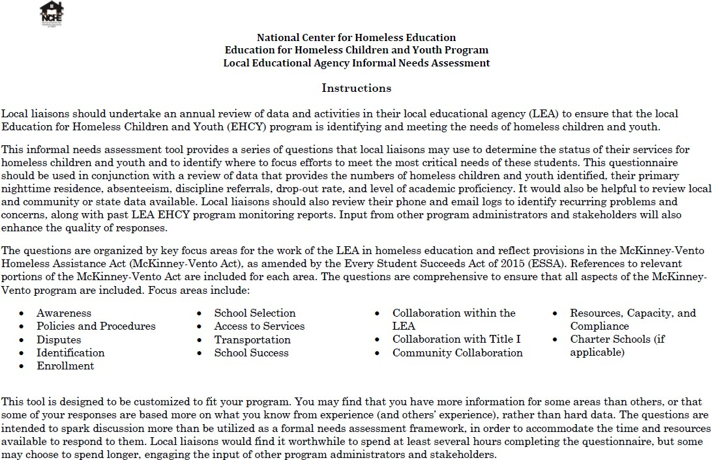
NCHE Needs Assessment Tool
Needs Assessment – National Center for Homeless Education
An Excellent Education for Every Student Every Day
12

Slide 13
Title I-A Set-aside Plan for Services
What is an LEA required to include in its Title I, Part A plan regarding services for homeless students?
Under section 1112(b)(6) of the ESEA, an LEA must describe in its Title I, Part A plan the services it will provide homeless children and youths, including services provided with funds reserved under section 1113(c)(3)(A) of the ESEA, to support the enrollment, attendance, and success of these children and youths.
An LEA’s Title I, Part A application also should include a description of the method used for determining the amount reserved, whether by a needs assessment or some other method (e.g., past homeless student enrollment and support service cost data), and how the liaison was consulted or involved in determining the set-aside.
Education for Homeless Children and Youths Program Non-Regulatory Guidance (see Section M on Coordination with Title I, Part A of the ESEA)

Slide 14
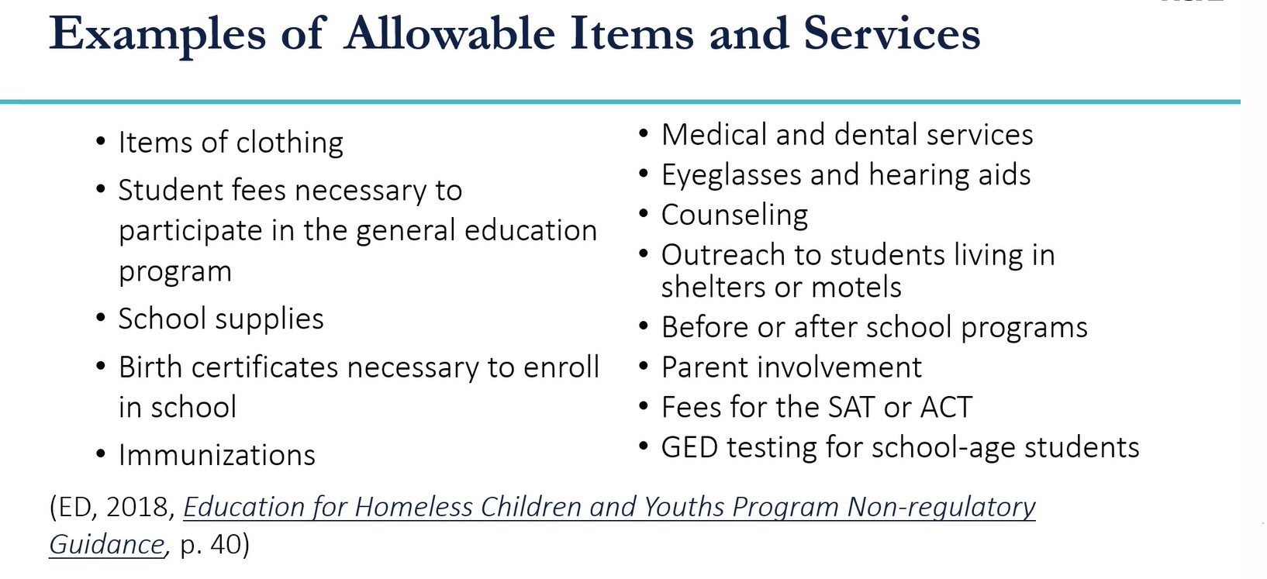
Title I-A Use of Funds
An Excellent Education for Every Student Every Day

Slide 15
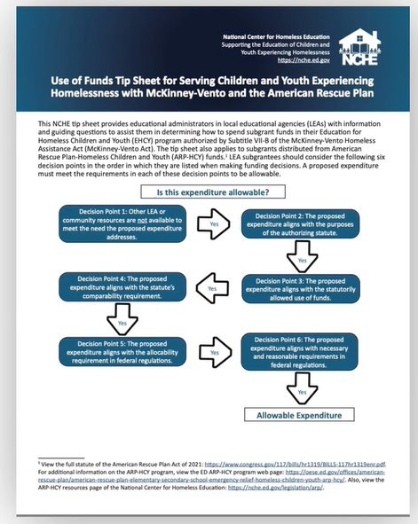
Title I-A Use of Funds (cont’d)
While this NCHE Use of Funds Tip Sheet is a helpful resource that was intended to guide funding decisions for the McKinney-Vento subgrants and American Rescue Plan Homeless Children and Youth (ARP-HCY) funds, many of the tips reference Uniform Grant Guidance that apply to Title I, Part A Homeless set aside funds.
An Excellent Education for Every Student Every Day

Slide 16
Title I-A Use of Funds (cont’d)
An Excellent Education for Every Student Every Day

Slide 17
NCHE Brief - Serving Students Experiencing Homelessness under Title I, Part A
An NCHE brief, from our McKinney-Vento Law Into Practice Series. Download here.
An Excellent Education for Every Student Every Day

Slide 18
Supplement, Not Supplant
Non-Regulatory Informational Document –SNS Final Guidance (PDF) (ed.gov)
Statutory Reference Section 1118(b)(1) An LEA shall use Federal funds received under this part only to supplement the funds that would, in the absence of such Federal funds, be made available from State and local sources for the education of students participating in programs assisted under this part, and not to supplant such funds.
An Excellent Education for Every Student Every Day

Slide 19
Title I-A Set-aside Review (table talk)
Are homeless children and youths who attend non-Title I schools eligible to receive Title I, Part A services?
How should an LEA determine the amount of funds to reserve for comparable services under Title I, Part A?
What kind of needs assessment should LEAs conduct related to homeless children and youths to determine a suitable set-aside for comparable services and additional educational support services?
What kind of needs assessment should LEAs conduct related to homeless children and youths to determine a suitable set-aside for comparable services and additional educational support services?
What is an LEA required to include in its Title I, Part A plan regarding services for homeless students?
How does your district –
Determine your Title I, Part A Set Aside? Conduct your needs assessment?
What is included in your plan? Who is involved in the process?

Slide 20
Education for Homeless Children and Youth (EHCY) Formula Grants
Formula grants are made to the 50 states, the District of Columbia, and Puerto Rico based on each state’s share of Title I, Part A, funds.
State educational agencies (SEAs) must ensure that homeless children, including preschoolers and youths, have equal access to free and appropriate public education (FAPE).
States must review and revise laws and practices that impede such equal access.
States are required to have an approved plan for addressing problems associated with the enrollment, attendance, and success of homeless children in school.
States must make competitive subgrants to local educational agencies (LEAs) to facilitate the enrollment, attendance, and success in school of homeless children and youths. This includes addressing problems due to transportation needs, immunization and residency requirements, lack of birth certificates and school records, and guardianship issues.

Slide 21
McKinney-Vento Subgrant Eligibility and Grantee Information
While only SEAs may apply and directly receive funds from the Department of Education, SEAs are, in turn, required to make formula subgrants to local educational agencies (LEAs).
Each State submitted a Consolidated State Plan in 2017 in order to receive funds under nine formula Grant programs, including EHCY. Copies of all current State plans, as well as information about the State plan process, may be found
at https://oese.ed.gov/offices/office-of-formula-grants/school-support-and- accountability/essa-consolidated-state-plans/.
An Excellent Education for Every Student Every Day

Slide 22
Eligibility and Grantee Information (cont’d)
Distribution of formula grant funds to participating States, the District of Columbia, and Puerto Rico under the Education for Homeless Children and Youth program is proportionate to the distribution of funds under Section 1122 of the Elementary and Secondary Education Act of 1965, as amended (ESEA).
The minimum grant that may be awarded to a State educational agency (SEA) in any given fiscal year is $150,000.
State educational agency must distribute not less than 75 percent of their allocation in subgrants to local educational agencies. States funded at the minimum level must distribute not less than 50 percent in subgrants to local educational agencies. States may reserve their remaining funds for State-level activities.
An Excellent Education for Every Student Every Day

Slide 23
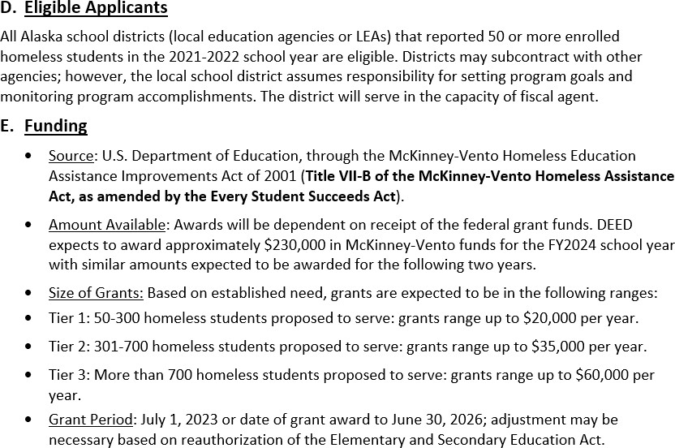
Eligibility and Grantee Information (cont’d)
An Excellent Education for Every Student Every Day

Slide 24
Awards
Awards to States | Fiscal Year 2021 | Fiscal Year 2022 | Fiscal Year 2023 | Fiscal Year 2024
Alaska | $300,845 | $323,811 | $372,689 | $368,645

Slide 25
Authorized Activities
A local educational agency may use funds awarded under this section for activities that carry out the purpose of this part, including the following:
The provision of tutoring, supplemental instruction, and enriched educational services that are linked to the achievement of the same challenging State academic standards as the State establishes for other children and youths.
The provision of expedited evaluations of the strengths and needs of homeless children and youths, including needs and eligibility for programs and services (such as educational programs for gifted and talented students, children with disabilities, and English learners, services provided under title I of the Elementary and Secondary Education Act of 1965 [20 U.S.C. 6301 et seq.] or similar State or local programs, programs in career and technical education, and school nutrition programs).
Professional development and other activities for educators and specialized instructional support personnel that are designed to heighten the understanding and sensitivity of such personnel to the needs of homeless children and youths, the rights of such children and youths under this part, and the specific educational needs of runaway and homeless youths.
An Excellent Education for Every Student Every Day

Slide 26
Authorized Activities (cont’d)
A local educational agency may use funds awarded under this section for activities that carry out the purpose of this part, including the following:
The provision of referral services to homeless children and youths for medical, dental, mental, and other health services.
The provision of assistance to defray the excess cost of transportation for students under section 11432(g)(4)(A) of this title, not otherwise provided through Federal, State, or local funding, where necessary to enable students to attend the school selected under section 11432(g)(3) of this title.
The provision of developmentally appropriate early childhood education programs, not otherwise provided through Federal, State, or local funding, for preschool-aged homeless children.
The provision of services and assistance to attract, engage, and retain homeless children and youths, particularly homeless children and youths who are not enrolled in school, in public school programs and services provided to non-homeless children and youths.
An Excellent Education for Every Student Every Day

Slide 27
Authorized Activities (cont’d)
A local educational agency may use funds awarded under this section for activities that carry out the purpose of this part, including the following:
The provision for homeless children and youths of before- and after-school, mentoring, and summer programs in which a teacher or other qualified individual provides tutoring, homework assistance, and supervision of educational activities.
If necessary, the payment of fees and other costs associated with tracking, obtaining, and transferring records necessary to enroll homeless children and youths in school, including birth certificates, immunization or other required health records, academic records, guardianship records, and evaluations for special programs or services.
The provision of education and training to the parents and guardians of homeless children and youths about the rights of, and resources available to, such children and youths, and other activities designed to increase the meaningful involvement of parents and guardians of homeless children or youths in the education of such children or youths.
The development of coordination between schools and agencies providing services to homeless children and youths, as described in section 11432(g)(5) of this title.
An Excellent Education for Every Student Every Day

Slide 28
Authorized Activities (cont’d)
A local educational agency may use funds awarded under this section for activities that carry out the purpose of this part, including the following:
The provision of specialized instructional support services (including violence prevention counseling) and referrals for such services.
Activities to address the particular needs of homeless children and youths that may arise from domestic violence and parental mental health or substance abuse problems.
The adaptation of space and purchase of supplies for any non-school facilities made available under subsection (a)(2) to provide services under this subsection.
The provision of school supplies, including those supplies to be distributed at shelters or temporary housing facilities, or other appropriate locations.
The provision of other extraordinary or emergency assistance needed to enable homeless children and youths to attend school and participate fully in school activities.
An Excellent Education for Every Student Every Day

Slide 29
Use of Funds
Use of Funds Tip Sheet: Both NCHE and the Department frequently are asked about whether a proposed use of funds is allowable and the answer is often that “it depends” on whether it can be considered reasonable and necessary and what other services are provided to all students or available in the district or community for students experiencing homelessness. It is a fact-specific, local determination and this tip sheet discusses six decision points in making that determination.
An Excellent Education for Every Student Every Day

Slide 30
An Excellent Education for Every Student Every Day
Questions?
34
An Excellent Education for Every Student Every Day

Slide 31
Contact Information
Adrianne Schwartz, Program Manager
adrianne.schwartz@alaska.gov (907) 465-8721
An Excellent Education for Every Student Every Day

Slide 32
Stay Connected
Website
education.alaska.gov
An Excellent Education for Every Student Every Day
Phone
Main Line: (907) 465-2800
Teacher Certification: (907) 465-2831
Social Media
@AlaskaDEED

