Slide 1
Perkins 101
Overview for new CTE Coordinators
Alaska Department of Education & Early Development
Fall Collaborative Chats TA Series
October 13, 2021
Recording Link:
https://us02web.zoom.us/rec/share/oX9PVNJ83PGvi1gw-reJBD4iC-36Usa-J1beClQOs-7a7ULhXdsc1M5K-DXgIbow.HMIQqj4lcjjaGYPU

Slide 2
Our Mission and Vision

Slide 3
Alaska’s Ed Challenge 5 Trajectories:
Early reading
Increase career, technical, and culturally relevant education to meet student and workforce needs.
Equitable educational rigor
Effective teachers
Safety and well-being

Slide 4
I have Questions about:
Notes:
In the chat – padlet.
https://padlet.com/ctegrants/35cucs6shjwomwid

Slide 5
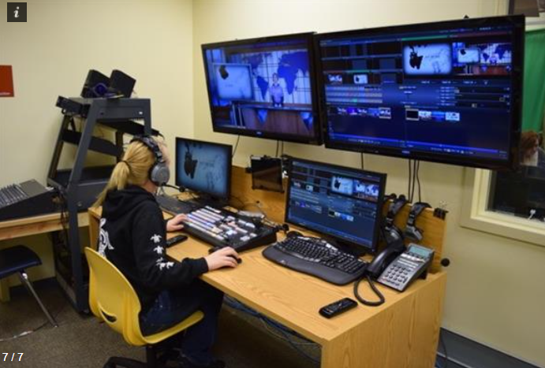
CTE Today / Perkins
Notes:
CTE Today is an organized education program - coherent sequences of courses in career pathways
Provides academic, technical, and employability skills and knowledge needed to prepare for future education and careers
Based on current industry standards
Focus of secondary to postsecondary transitions and partnerships
A complete secondary/postsecondary education program that leads to industry certification, recognized postsecondary credential, associate degree, baccalaureate degree
PERKINS is Federal formula grant program meant to expand, improve, and enhance (not maintain) existing CTE programs. Perkins supplements!
District allocations based on census and poverty data
Perkins is federal money – state (DEED) and local grantees (districts) must follow the rules!
Perkins targets federal priorities in local CTE programs

Slide 6
Alaska Perkins Funding (~$5.4 million)
Notes:
Secondary Grants plus reserve = 4,416,000 TOTAL to secondary districts
Allocations are a bit higher than normal this year due to shuffling of unspent funds during Covid.

Slide 7
Perkins V Requirements

Slide 8
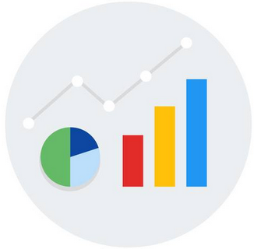
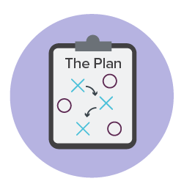
Process – Alaska Perkins V Requirements
Advisory Committee
CTEPS
Four-Year Plan & Local Application
All-In-One
(Portal)
Comprehensive Local
Needs Assessment
(CLNA)
Annual Amendment (GMS)
This Photo by Unknown Author is licensed under CC BY-SA
Notes:
CTE Advisory Committee: Active, with specified CTE stakeholder groups represented. Agenda/Attendance/Minutes document required annually, which also must include data review.
Comprehensive Local Needs Assessment: Identifies the gaps in CTE instruction in the district and areas of need in 5 categories. Workbook optional and Results Document required
Four-year plan: This is the APPLICATION. Provides a description of what programs are currently in place, and what will be implemented to specifically address Perkins needs identified in the CLNA.
Annual Amendment: Update 4-year CTE Application (if needed), submit a budget, and report on any core performance indicators not met. GMS document
All-in-One Report: Submit student performance data on core performance indicators to inform the Advisory and CLNA. Portal document

Slide 9
Every 4 Years
Four-Year Plan and Local Application
• This is the Perkins application.
• Fully describes meeting Perkins requirements in all 5 Parts.
• Planning for activities and expenditures to address needs identified in the CLNA.
(not necessarily for all 5 Parts)
Every 2 Years
Comprehensive Local Needs Assessment (CLNA)
• CLNA drives all expenditures.
• Needs/Goals identified go directly into the Four-Year Plan and Local Application.
• Annual budget items must be tied to the CLNA.
Annual Tasks
• Advisory Committee meeting. (minutes)
•All-In-One. June 15th
• GMS Annual Update:
1. Substantially Approved - Assurances, Advisory Committee minutes, budget
June 30th to allow expenditures as of July 1
2. Fully Approved -
*Annual Updates to 4-Year Plan (if needed)
*Final Budget
*Core Performance Indicator improvement plans (if needed)
*Updated CLNA, 4-Year Plan/Application uplodaded, if needed
September 30th to qualify for reallocaton funds
Notes:
4 Years – Heaviest lift – contains 2 things:
Current detailed description of the program in place for 5 categories, showing it meets the requirements of Perkins (statues listed n the 4-Year Plan document)
PLAN – the planning portion of the 4-year plan is based on what the district will spend funds on to address needs identified in the CLNA. These plans can be modified over time as new data arises in the Annual Update
2 Years –
CLNA - review data for all 5 Parts of Perkins application
Identify needs and goals for each of the parts funds will be expended for in the next 4 years – can prioritize (REPORT FORM Uploaded)
All budget items are Tagged to one of the 5 parts – need, which leads to 4-year planning, which leads to expenditures.
Annual –
Advisory Committee – spring recommended – must have date, attendance, minutes – include a review of student data. Upload to GMS
All-In-One – through the Portal – student data collection for the core performance indicators
GMS – should be quick – budget, some fed requirements (assurances, private schools) any updates to your 4 year plan IF NEEDED (welding shop burned down, shifting plans to rebuild it) keep in mind expenditures and original CLNA, and Core Performance Indicator improvement plans, if needed.

Slide 10
Questions?

Slide 11
The Heart of Perkins CTE
CTEPS
Sequences are the fundamental principle of Perkins
A sequence that contains 2 credits and post-secondary alignment is a CTE Program of Study (CTEPS)
Perkins requires ONE complete CTEPS to qualify for Perkins funding
Courses and CTEPS are approved for 5 years – update as needed - ongoing
This Photo by Unknown Author is licensed under CC BY-SA
Notes:
CTE Programs consist of sequences –courses that go together, that have academic and technical standards included, and certifications wherever possible
Sequences become Programs of Study (CTEPS) – when they have at least 2 credits, in a single career pathway, and include postsecondary alignment.
Perkins courses should strive to be organized sequences and grow into Programs of Study (CTEPS) wherever possible, to provide the most robust opportunity for students

Slide 12
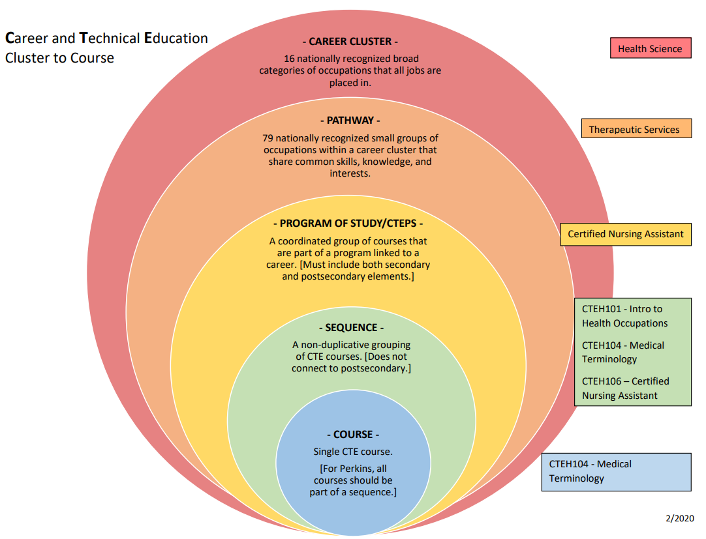
Course to Cluster Venn Diagram
Notes:
This diagram illustrates how courses fit into sequences, CTEPS, and Career Clusters.

Slide 13
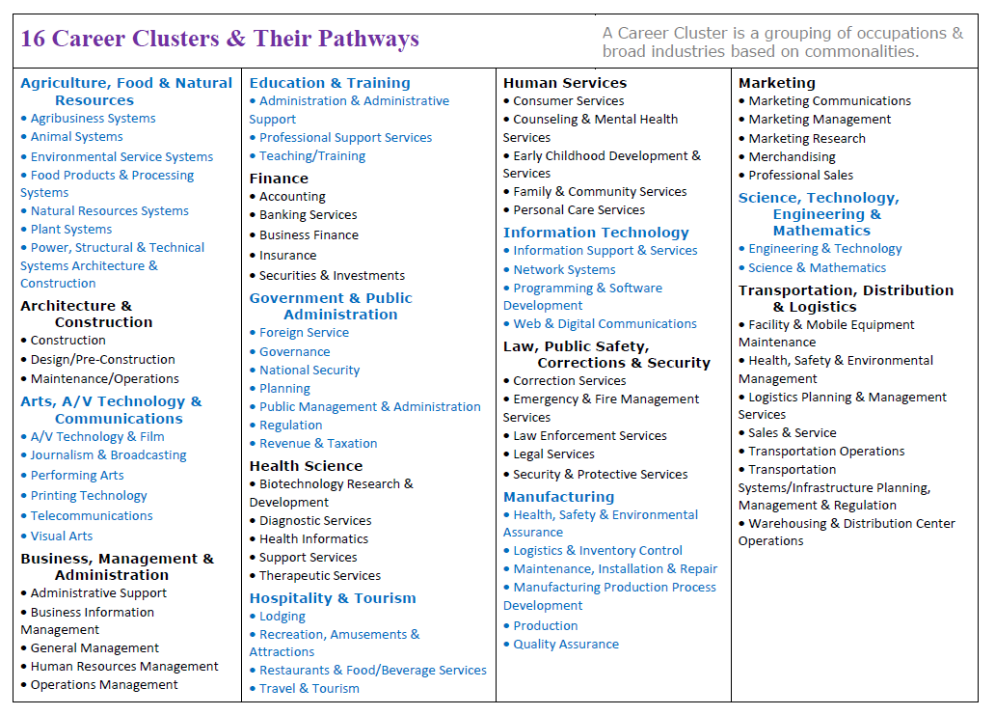
Notes:
Nationally – these are the Career Cluster areas and Pathways. Good idea to familiarize yourself with these.

Slide 14
CTEPS/CTE Program of Study
1 Technical Credit
(minimum)
1 Foundational or
1 Technical
Credit
CTEPS
Specific
area of study
+ Postsecondary Alignment
CTEPS
2 credits (minimum)
Any combination of credit:
0.25
0.5
1
Any combination of credit:
0.25
0.5
1
2 credit minimum
Notes:
CTEPS/CTE Program of Study
Required – at least one CTEPS (CTE Program of Study)
Program and CTEPS Must be of sufficient size, scope, quality
A CTEPS is: A sequence of CTE courses
2 credits
Minimum of 1 technical credit
Specific area of study, pathway or cluster
Aligns to postsecondary program(s)

Slide 15
Questions?

Slide 16
Advisory Committee
Must have an ongoing role in advising programs
Members fill required roles
Must meet at least annually to review district Perkins performance data and consult
Minutes of meetings must be uploaded into GMS annually.
Notes:
CTE Advisory Committee has a required slate of members.
Continued Consultation requirement of Perkins V means Advisory Committee has an ongoing role and is required to review the district’s performance data annually.
Advisory Committee Agenda/Attendance/Minutes must be uploaded to GMS Annual Amendment each year.

Slide 17
Comprehensive Local Needs Assessment (CLNA) every 2 years
Foundation of implementation at the local level
Evaluates needs within 5 key areas (Parts A-E)
Identifies specific program needs (Findings)
Identifies SMART goals
Drives all expenditures
Notes:
CLNA needs to be updated every 2 years.
The CLNA workbook is an INTERNAL document, designed to help districts identify data sources and ask questions that will facilitate a comprehensive review.
There is a Results form that lists identified needs and goals, this is uploaded to GMS.
FINDINGS – might not have a Finding or a need in each section, but all EXPENDITURES must be connected to a FINDING.
NEEDS – A need should be specific, based on data collected, and identify a gap between what is and what should be.

Slide 18
Four-Year Plan & Local Application
Application –all Parts A-E must describe current program fully – demonstrates that Perkins V requirements are met
Details improvement plans to meet CLNA needs in Parts A-E as needed (directly aligned with CLNA/Budgets)
Describes funding needed to support improvement plans
Notes:
Remember that this is the Application! It must be ROBUST.
This document is uploaded to GMS once every 4 years.

Slide 19
Annual Amendment (GMS)
Completed in Grants Management System (GMS)
Amendments to the Four-Year Plan and Local Application Parts A-E (if needed)
Student Achievement Improvement Plans (if needed)
Budget – aligned to CLNA
Supporting Documents –
Advisory Committee - Agenda/Minutes (required)
CLNA (if needed)
Four-Year Plan and Local Application (if needed)
Notes:
THIS IS NOT YOUR APPLICATION!!
Annual amendment is broken into sections in GMS:
Update/review of Names on your Advisory Committee
Budget
Some Federal Compliance things – Assurances/Private School consultation, etc.
If Student Accountability measures are not met – short improvement plan goes here annually.
Parts that align to the CLNA –
AMENDMENTS – if something has happened – you’ve updated your CLNA, key CTE teachers left, a building burned, or something else unforeseen – you’ll probably need to AMEND your 4-year plan. Otherwise – if the current plan is still good – NO AMENDMENT NEEDED

Slide 20
All-in-One Report (Portal)
Districts submit CTEPS and Course crosswalk documents for approval and storage
Districts report student Perkins data – All-In-One
Data from the AIO is used to inform the:
Local Advisory Committee
District CLNA
Notes:
AIO Includes:
Student enrollments
Student performance data
Student demographics
PORTAL – is also an online tool.

Slide 21
Questions?

Slide 22
Program Framework: Parts A-E

Slide 23
Program Parts A-E
Notes:
Parts A-E come from the organization of the CLNA in the Perkins V law (section 134c)
DEED Documents CLNA, 4-Year Plan and Application, Annual Amendment in GMS all support the 5 parts and are organized around them
It’s useful when considering your program to look at it though the lens of these broad parts as you evaluate, plan, and spend.

Slide 24
Notes:
Not going to go through this – too much text – but this document should be reviewed to understand what elements are in each part.

Slide 25
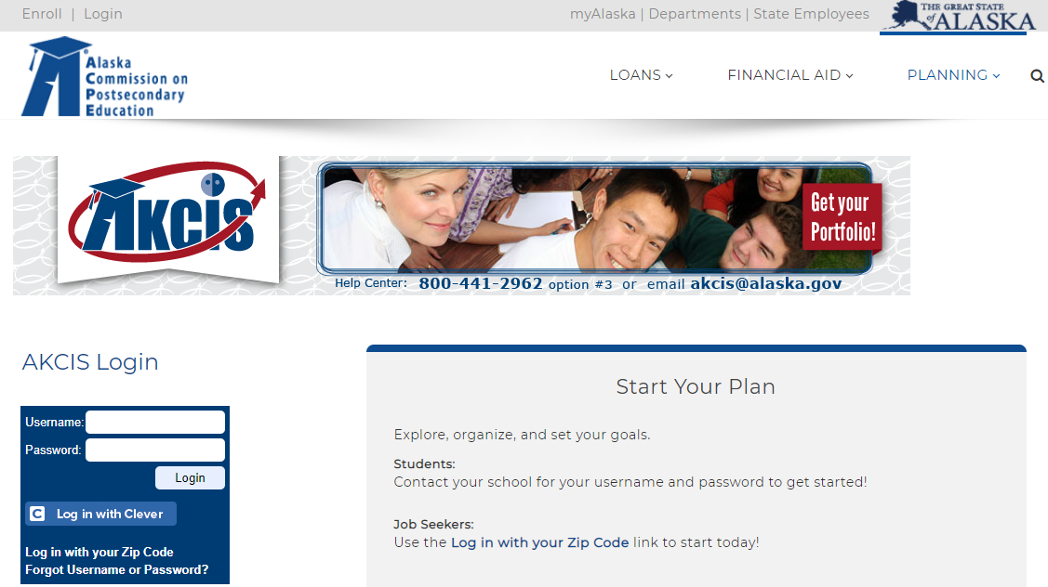
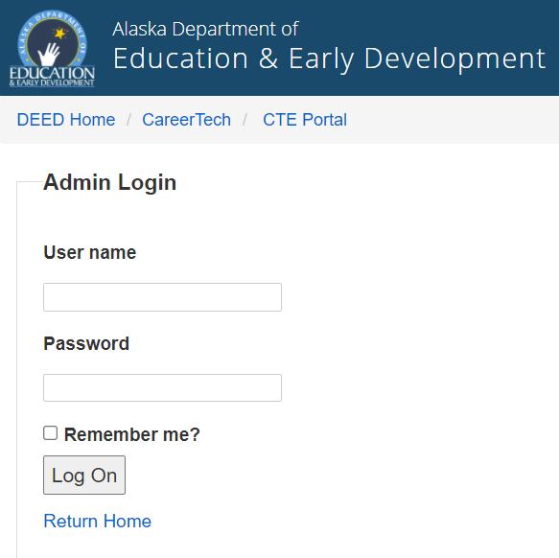
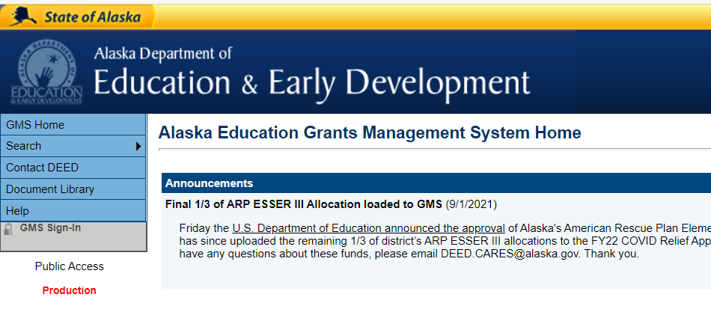
DEED Tools
Notes:
DEED uses the Portal – on the left, for Course approval and organization, and for student data interface. User name and Password for each district.
DEED provides AKCIS – upper right – as a foundation for organized system of career guidance – students can do interest surveys, save resumes and letters of recommendation, search postsecondary options, and access applications for over 3,000 scholarship opportunities. Training for this tool is available – Julia Renfro ACPE!
DEED uses GMS – grants management system – for annual budgets and misc. requirements. Document Library for your use, uploads of CLNA, Advisory Committee Minutes, 4-year plans/applications. Each PERSON has roles, a user name and password for this system.

Slide 26
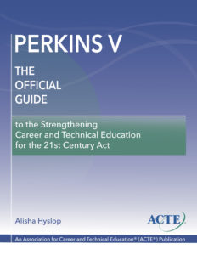
Resources
Notes:
This book is an excellent resource. All districts received one, so there should be one somewhere.

Slide 27
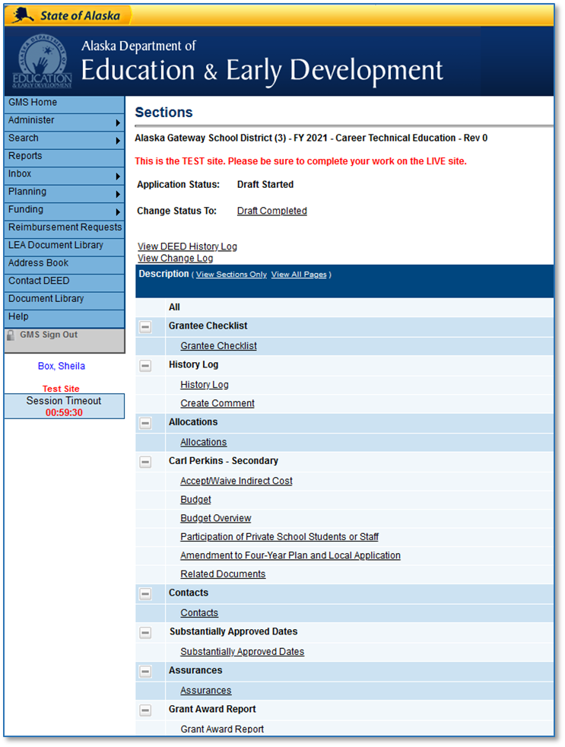
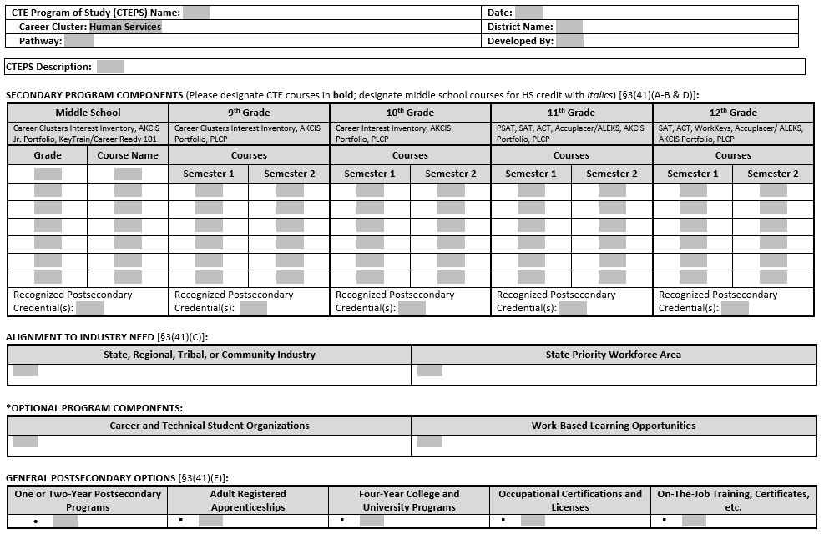
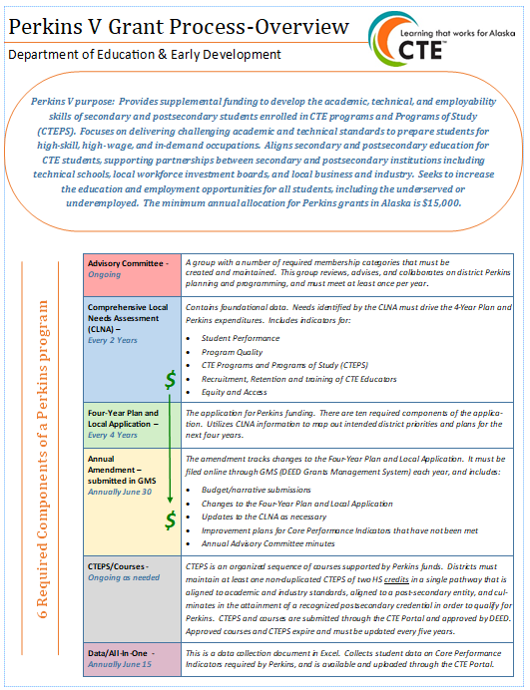
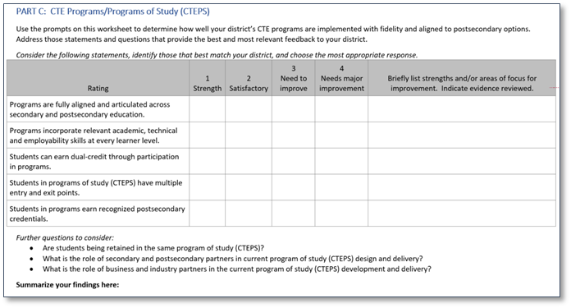
More Resources
Notes:
There are a bunch of forms, one-pagers, guides, etc. Don’t search – ASK US for what you need.

Slide 28
Questions?

Slide 29
Follow Up: Perkins 102
Deeper Dive
Stakeholder Engagement
Budget Questions
Fiscal Restrictions
CTEPS questions – is this a sequence?
Core indicators
5 Parts A-E
Notes:
Please indicate in the chat if you would like to participate in a follow-up training.

Slide 30
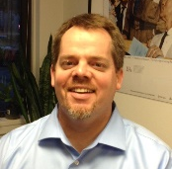
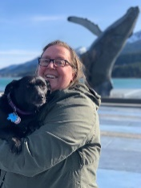
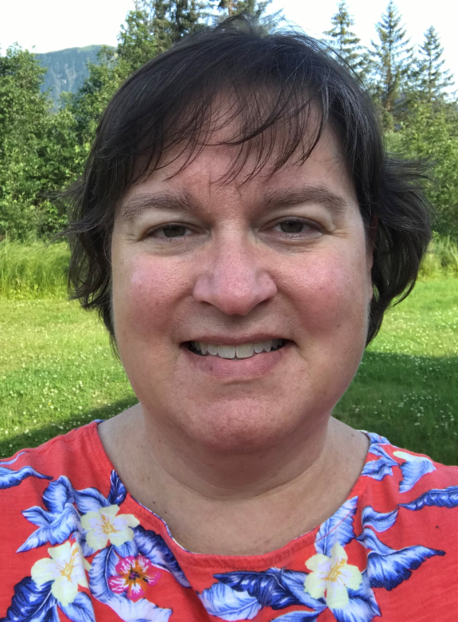
DEED CTE Team
Deborah Riddle
Division Operations Manager, Innovation & Education Excellence
907-465-2892
deborah.riddle@alaska.gov
Brad Billings
Administrator, Career and Technical Education
907-465-8720
brad.billings@alaska.gov
Sheila Box
CTE Program Specialist
907-465-8704
sheila.box@alaska.gov
Felicia Swanson
Education Associate
907-465-2980
felicia.swanson@alaska.gov
Bjørn Wolter
CTE Program Specialist
907-465-6542
Bjorn.wolter@Alaska.gov

