Slide 1
Grants Management System (GMS)
Training Module 9
MODULE
9
User Access Administrators
Role
Creating Users
Creating Roles
Maintenance
Notes:
Module 9 is specifically for User Access Administrators at the district/grantee level.
It explains what a UAA is, what their responsibilities are, and how to add users and roles to GMS

Slide 2
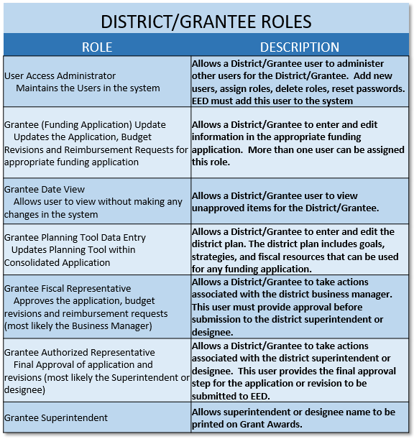
User Access Administrator (UAA) Role
User Access Administrators
One or two people per district (DEED must assign the UAA role) who are responsible for district level access to GMS including:
Creating new users
Giving users roles
Removing roles from users who are no longer employed
Keeping a log or paperwork (form provided by DEED) for all users in GMS for the district

Slide 3
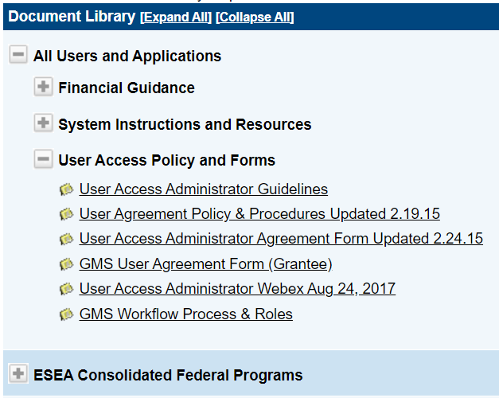
Who Assigns Roles?
DEED Assigns:
User Access Administrator – Requires form signed by superintendent
Contractors for multiple districts – i.e. SERRC, so they may use one email
UAA Assigns:
All other district level roles
Forms in the Document Library
UAA role assigned by DEED
GMS User Agreement Form for district use

Slide 4
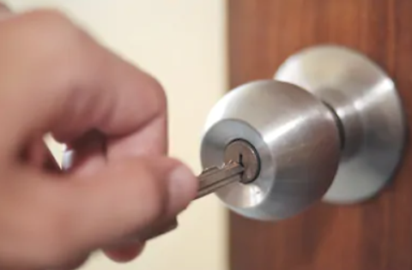
UAA Responsibilities
User Access Administrators must keep Users and Roles current in GMS:
Security - Access to GMS must be secure so that unqualified people cannot change applications or budgets in GMS
Communication - DEED uses GMS user information (phone, email) to contact staff with responsibilities for grants in the district
Remember: User Roles in GMS are like keys to the building – they must be removed when an employee leaves the district!

Slide 5
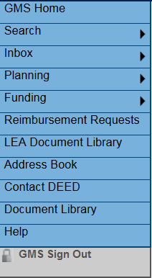
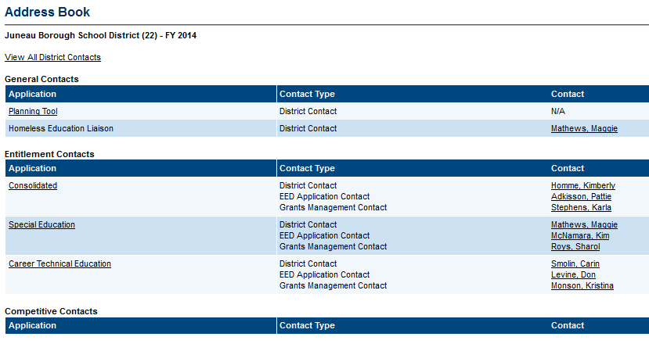
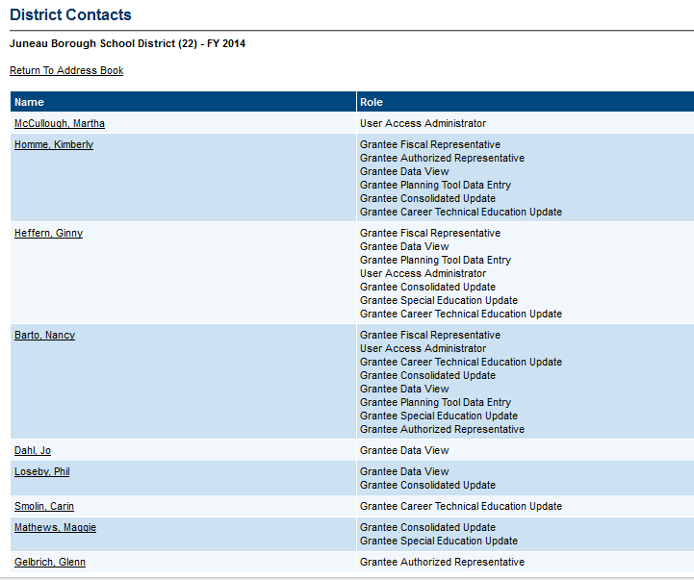
Viewing All Users and Roles
Static Menu – Select Address Book
Address Book – Select View All District Contacts
District Contacts Page shows all Users and Roles
Notes:
From the Static Menu Bar – Select Address Book
If you select View All District Contacts, you will get a list of all users and their roles that have been added for the district.

Slide 6
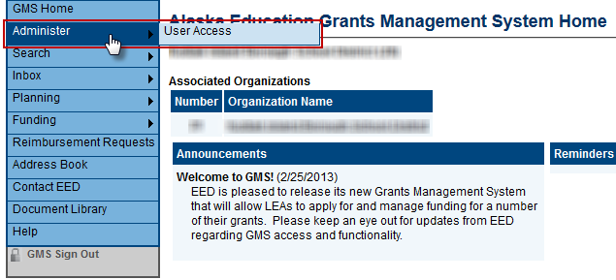
User Access Administrator Menu
User Access Administrators Only:
Mouse over Administer, then select User Access from the sub-menu

Slide 7
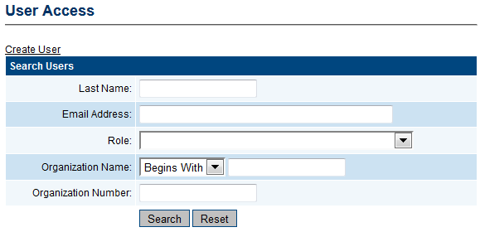
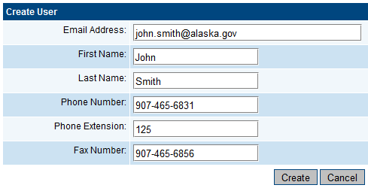
Create New User
UAAs should create users and assign roles CAUTIOUSLY! Once created, users cannot be erased from the system!
From User Access Page
Select Create User
Fill in ALL details! DEED and GMS both use this contact information!
Select the Create button at the bottom
Newly created users will get a ‘set password’ email from GMS
Notes:
Once you add a user, that email cannot be deleted. However, deleting all ROLES (access) essentially makes that user the same as any other person from the public in terms of access.

Slide 8
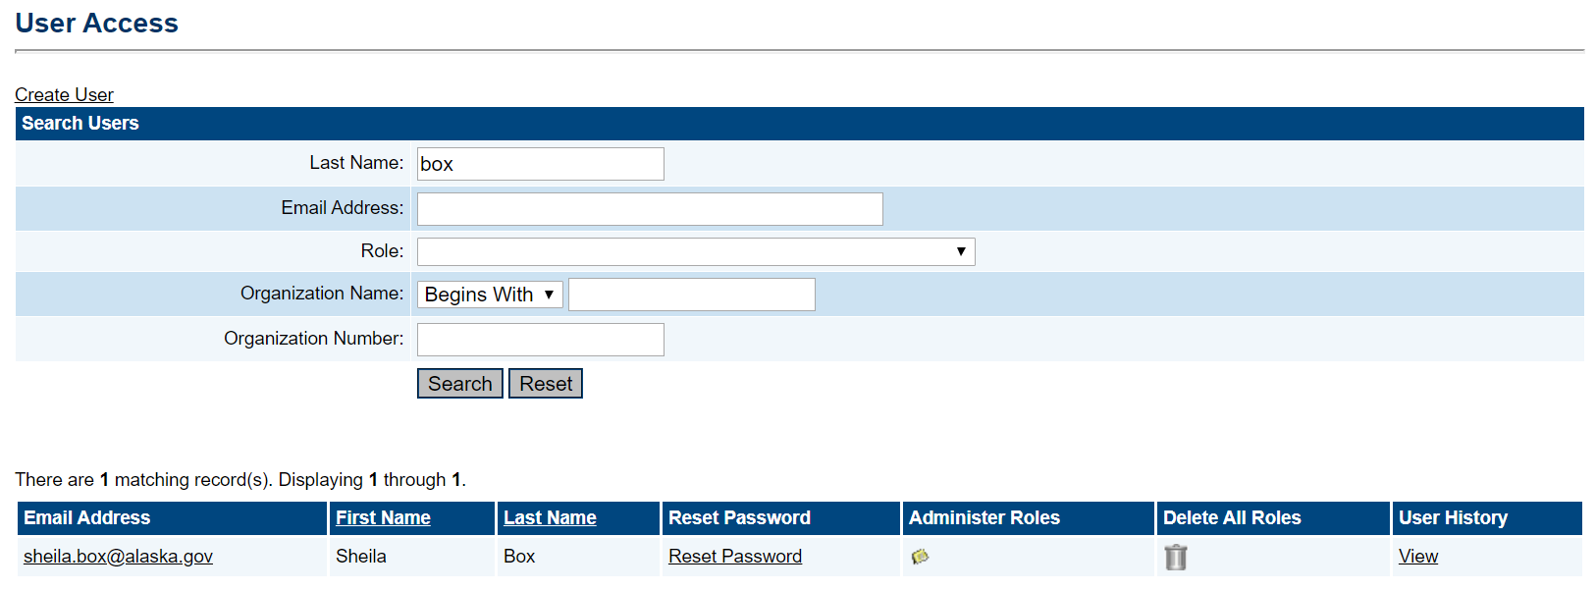
Assign Roles
Once a user has been created:
Search Users – enter last name
Select icon under Administer Roles – make sure it’s the correct name!
Select Create Role

Slide 9
Create A New Role
Select the Correct Organization from drop down - IMPORTANT!
Select the Role from the drop down
Select the Create button – repeat as necessary for multiple roles

Slide 10
Deleting Roles
Once a user has been identified:
May Delete All Roles – NOT Recommended – make sure it’s the correct name!
Select Administer Roles, and delete the roles one at a time using the garbage can

Slide 11
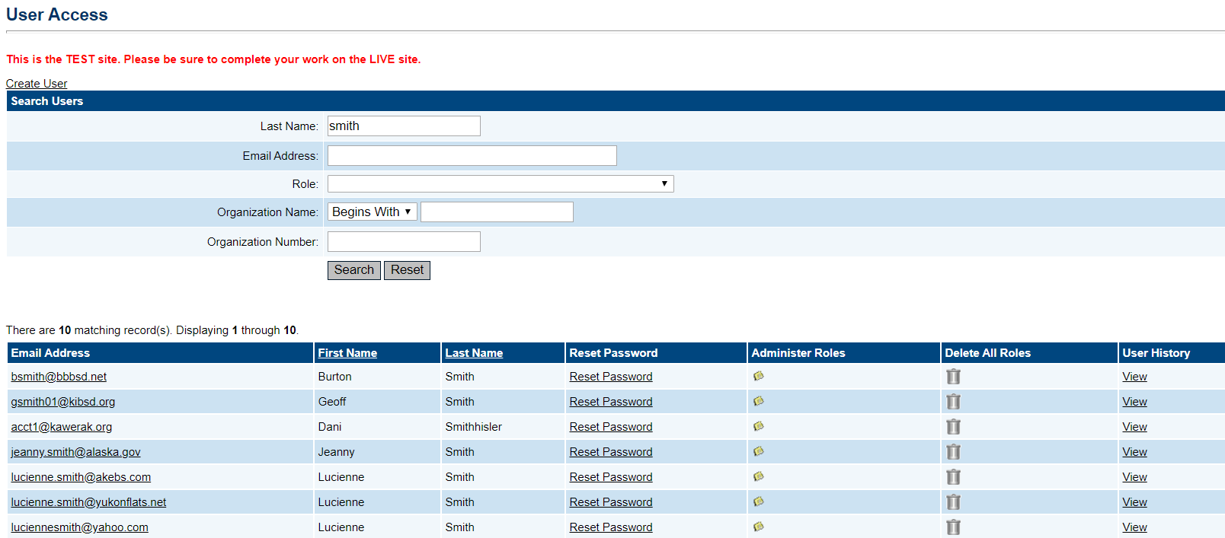
Reset Password
UAA may also Reset Password for their users, and View User History if needed – Remember – Always double check you are working with the correct name!

Slide 12
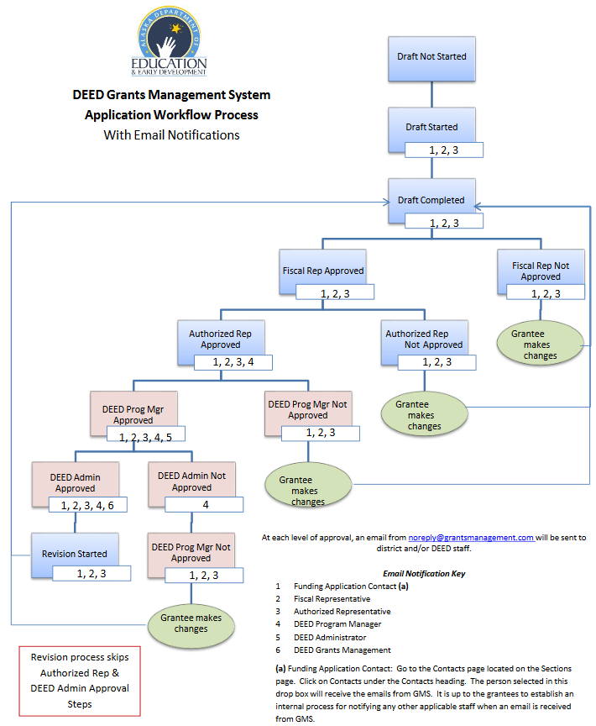
New User Tips
UAA should make sure that new users:
Receive password email from noreply@egrantsmanagement.com
If not, check junk mail settings
Understand what roles they have
Understand that GMS will send notifications according to workflow
Review Training Modules 1-9 located in the GMS Document Library under CTE

Slide 13
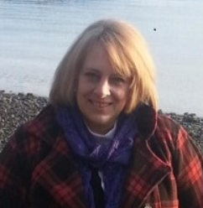
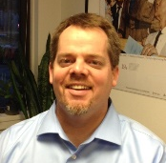
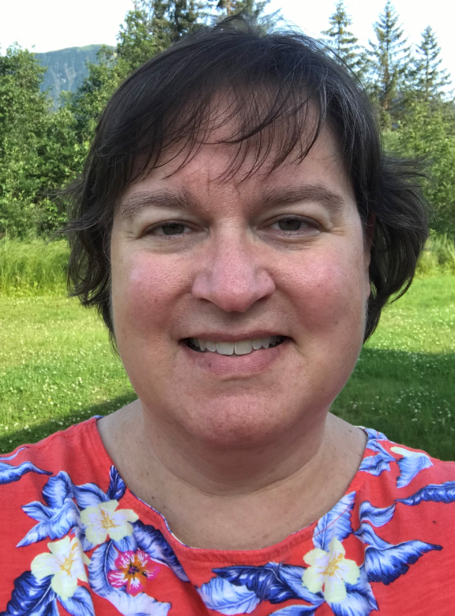
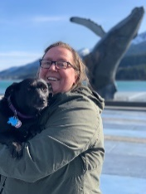
DEED/CTE Team
Deborah Riddle
Division Operations Manager, Innovation & Education Excellence
907-465-2892
deborah.riddle@alaska.gov
Brad Billings
Administrator, Career and Technical Education
907-465-8720
brad.billings@alaska.gov
GMS Specialist
Sheila Box
CTE Program Specialist
907-465-8704
sheila.box@alaska.gov
Felicia Swanson
Education Associate
907-465-2980
felicia.swanson@alaska.gov
Bjørn Wolter
CTE Program Specialist
907-465-6542
Bjorn.wolter@Alaska.gov
Notes:
This is the CTE team.
Contact any of us with CTE questions
Sheila is the GMS specialist on the team – call her with questions specific to GMS

