Slide 1
Grants Management System (GMS)
Training Module 3
MODULE
3
Allocations
Indirect Accept/Waive
Budget Pages
Budget Narratives
Budget Revisions
Notes:
Module 3 will walk the user through the funding pages – where to find the allocations, accept indirect, and complete budgets and narratives.

Slide 2
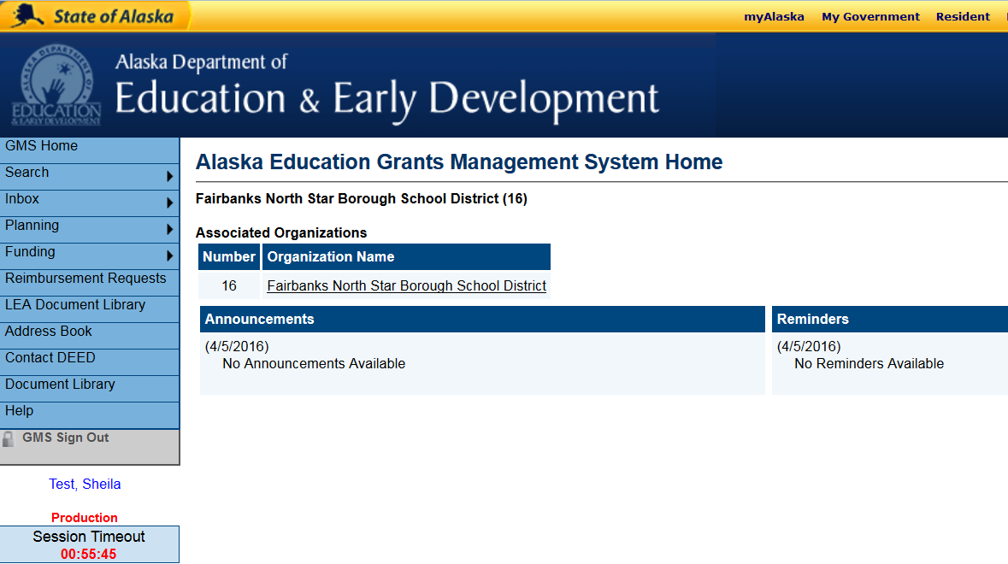
Starting A New Application
When you first sign into GMS, you should see your district name. There may also be announcements or reminders.
Select underlined District Name to see all grants associated with the district.
Notes:
In GMS all grants and revisions are saved electronically. Users can go back to prior years, see what revisions were made and when, and review history to read what actions have been taken for a specific grant.

Slide 3
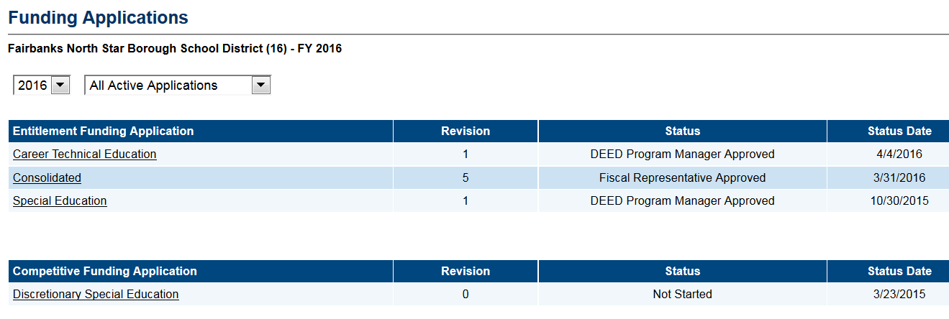
Funding Applications Page
Shows all applications for a district – select year and application status from drop down boxes
All Active Applications = Lists approved and not yet approved applications
All Approved applications = Lists only approved applications
Revision # - 0 is the Original application, 1, 2, 3, and so on are Revisions
Status = Current Status
Status Date – Date the status changed to its current state
You must RETURN to this page and select the CURRENT grant to continue working in the ‘live’ grant
Notes:
There is a lot of information on the Funding Applications page, please take a moment to familiarize yourself with this page.

Slide 4
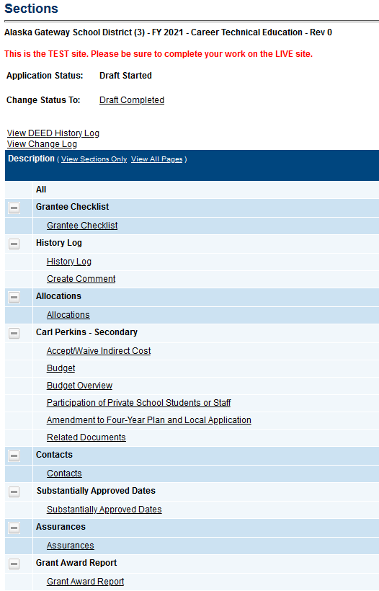
Budget Pages
STATUS
Application STATUS must be DRAFT STARTED before any work may be entered!
Budget Pages
Allocations
Accept/Waive Indirect Cost
Budget
Budget Overview
Grant Award Report
Notes:
There are several pages on the Sections page related to the budget.

Slide 5
Allocations Page
The Allocations page displays the amount allocated to each grant.
All allocations are PRELIMINARY when the application is first opened, and subject to change until final funds are received from USDOE – usually late July
Amounts may be updated during the year (adding Reallocated funds for Perkins)
When new allocations are added, DEED changes the grant status to Draft Started
Notes:
Allocations – amount allocated to each grant.
Preliminary when the application is first opened.
Subject to change until final state amount is received from USED in late July
Allocation amount may also be increased during the year (adding Reallocated funds for Perkins)
DEED changes the grant status to Draft Started when allocation changes are made

Slide 6
Budget Overview Page
Shows totals for all Account Codes on one page
This is an easy way to view the entire breakdown of all budgets. No entry can be made here
You may Filter by Location – to select a single school’s expenditures, if they are tagged in the main budget page
You may Show or Hide Unbudgeted Categories

Slide 7
Accept/Waive Indirect Cost Page
From the SECTIONS page, select Accept/Waive Indirect Cost
Indirect rates are pre-loaded, and districts must choose to accept indirect cost rate in order for it to be applied
All budget items entered except those located below the Indirect account code will have indirect automatically calculated

Slide 8
Copy Prior Year Budget
ONE TIME option – must be done BEFORE you enter a budget item for the FIRST time!
Select Copy (year) Budget Detail
Budget Detail Copy Confirmation page will open
Notes:
GMS will copy budget items and narrative from the last approved version of the prior years application

Slide 9
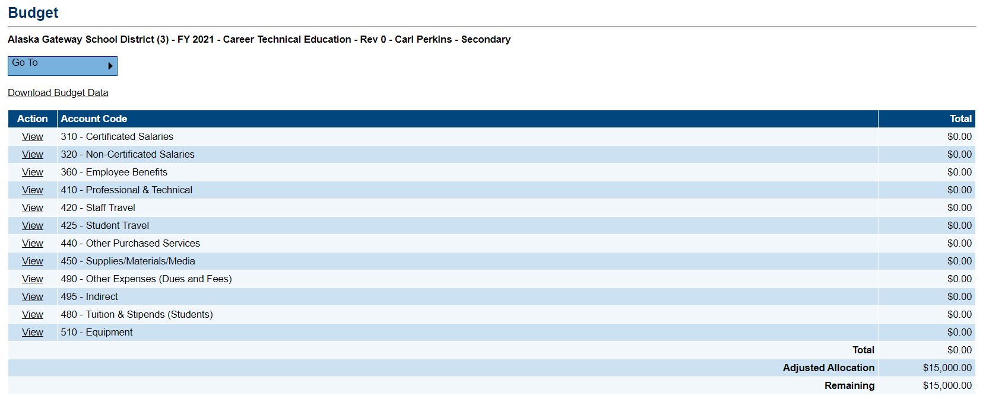
Budget Page
Action column must read Modify in order to accept changes – check STATUS
Instructions for Download and Upload Budget Data (See Module #8)
Each Account Code has a row, (i.e. 310 – Certificated Salaries) and items within that row will total. The entire row totals in the right hand column
Notes:
If the Action column says “View”, this means the user cannot enter information because the status of the application doesn’t allow it. Check the status. Budgets may be uploaded or downloaded via Excel, see Module #8 for detailed instructions.

Slide 10
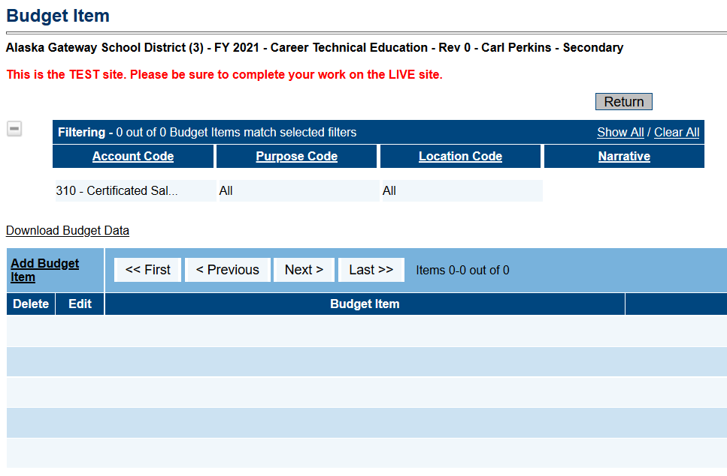
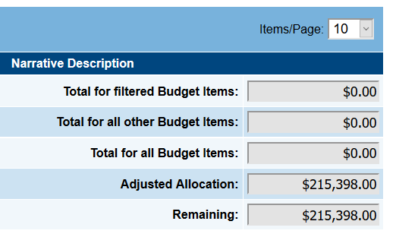
Budget Item Entry
The Budget Item page allows for filtering at the top
Filtered items are totaled separately
More on Tagging/Filtering (See Module #7)
Notes:
Main page – allows you to Add items
Filter items
Shows Filtered Total on the Right hand side

Slide 11
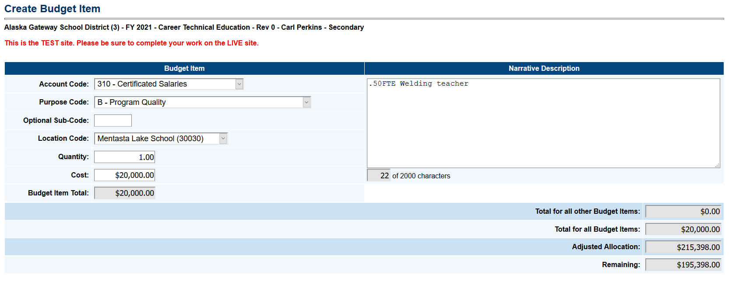
Create Budget Item Page
Completed budget items must have:
Account Code
Purpose Code – Must tie to CLNA Parts A-E
Location Code – Districtwide or school specific
Quantity/Cost
Narrative – must be tied to approved course

Slide 12
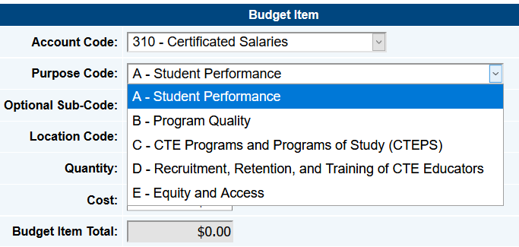
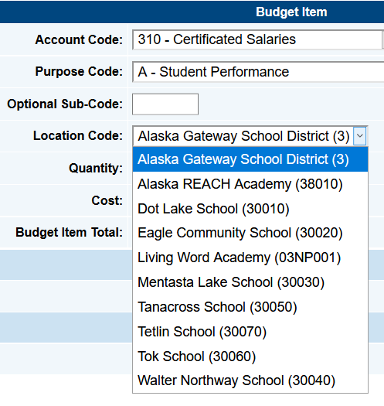
Create Budget Item – Budget Codes
Create each new budget item using appropriate codes
The Optional Sub-Code is optional if the District has extra coding – must include in reimbursements if used

Slide 13
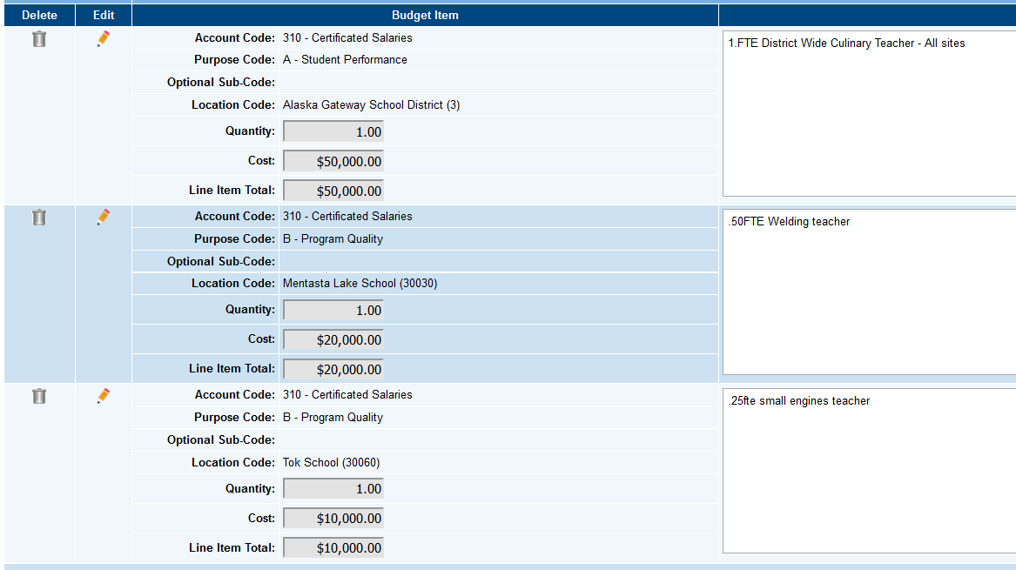
New Budget Items – Edit or Delete
In Modify – Budget items view
Each item shows ‘tags’
Each item shows narrative
Items may be deleted here
Items may be edited here
Notes:
Edit and Delete Options
Modify Lists all items showing all the details
Still have the main budget page with the same format – totals by account code only

Slide 14
Budget Pages - Tips
60 Minute Timeout - Save and Return or Go To
Set up your budget so that items may be easily deleted and funds moved if budget revisions are necessary
GMS saves each approved budget revision, in case review is necessary
Budget narratives must be complete enough for program managers to verify allowable expenditures
Connect all staff/training/equipment to an approved course
Don’t use Acronyms
“Supplies” is not enough – estimate type and number of items – “4 welding helmets”
Don’t forget- the clock is ticking!
Notes:
Remember that when DEED reviews the budget we are looking to verify that expenditures are allowable. All Perkins expenditures must be tied to an approved course. There are a variety of other rules that must be followed. Simply stating “Supplies” doesn’t give DEED the information we need to make that determination.

Slide 15
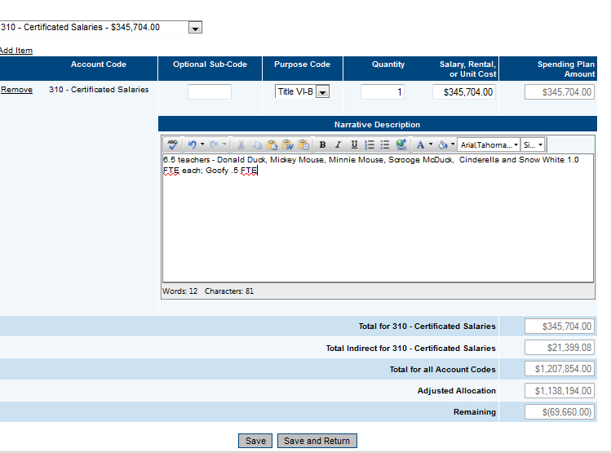
Budget Revisions
Don’t Forget!!
12/3/19 – Snow White welding class cancelled 2nd semester, move 20,000 to supplies
REVISION NARRATIVE
Date the change
Say why
Notes:
Revisions – please DATE and say why -

Slide 16
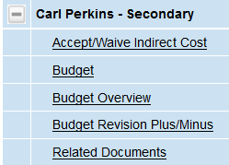
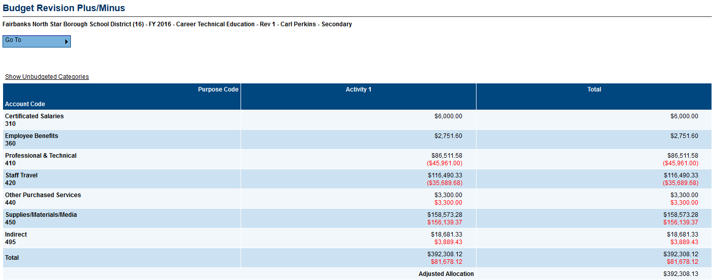
Budget Revision Plus/Minus
From Sections page, select Budget Revision Plus/Minus to show the movement of funds from the most recent approved revision by account code. This may also be PDFd and printed/saved using the print function on the Sections Page (See Module 5)

Slide 17
Budgeting Notes
Status – Application must be Draft Started status to receive entries. Only 1 revision may be in process at a time, and must be approved by DEED before a second revision may be started
Open revisions must be approved by DEED before a reimbursement may be submitted. Communicate with your business manager to ensure budgets are aligned with expenditures
GMS will not allow expenditures over 110% in any account code line. Reimbursement requests for excess expenditures will result in an error message.
Remember to update applicable program pages to support major budget changes not in the original application or supported by existing CLNA and 4-Year Plans
Workflow Note: Revisions only have to be approved through Fiscal Representative Approval

Slide 18
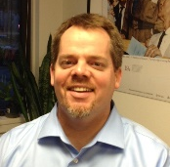
DEED/CTE Team
Deborah Riddle
Division Operations Manager, Innovation & Education Excellence
907-465-2892
deborah.riddle@alaska.gov
Brad Billings
Administrator, Career and Technical Education
907-465-8720
brad.billings@alaska.gov
GMS Specialist
Sheila Box
CTE Program Specialist
907-465-8704
sheila.box@alaska.gov
Felicia Swanson
Education Associate
907-465-2980
felicia.swanson@alaska.gov
Bjørn Wolter
CTE Program Specialist
907-465-6542
Bjorn.wolter@Alaska.gov
Notes:
This is the CTE team.
Contact any of us with CTE questions
Sheila is the GMS specialist on the team – call her with questions specific to GMS

