Slide 1
Grants Management System (GMS)
Training Module 4
MODULE
4
Related Documents
Assurances
Contact
Grantee Checklist
Notes:
Module 4 explores more pages in GMS related to supporting documents and processes used by DEED

Slide 2
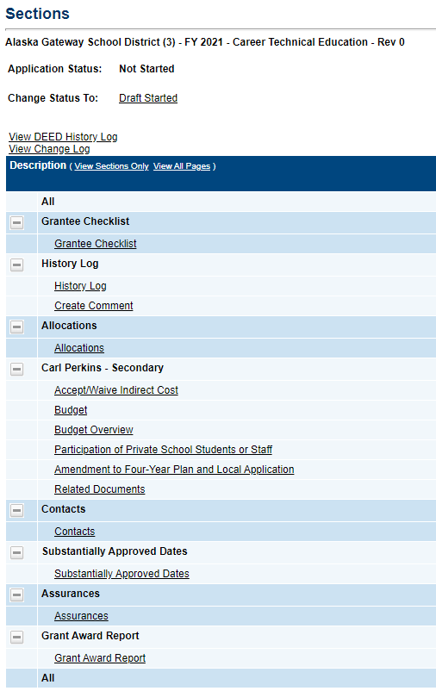
More Grant Pages
Grantee Checklist
DEED provides instructions for Applications/Revisions sent back Not Approved
Related Documents
Grantees upload supporting documents
Contacts
Grantees select a user to receive GMS emails and who DEED will contact with grant questions
Assurances
Federal Assurances

Slide 3
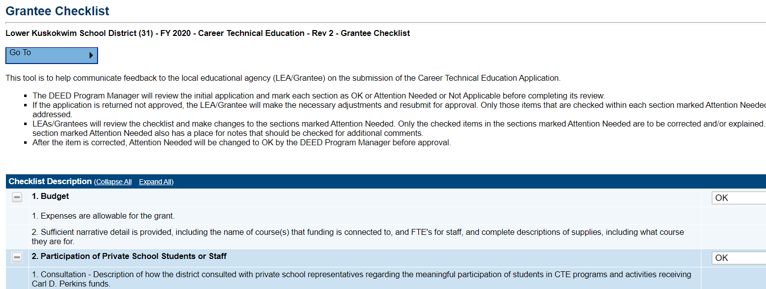
Grantee Checklist
Every time a grant is sent back Not Approved –instructions will be here
Each item (1. Budget, 2. Participation….etc.) corresponds to a page in the grant
For each page that is not approvable, there will be a text box with instructions
Contact your DEED Program Manager with questions about what is required

Slide 4
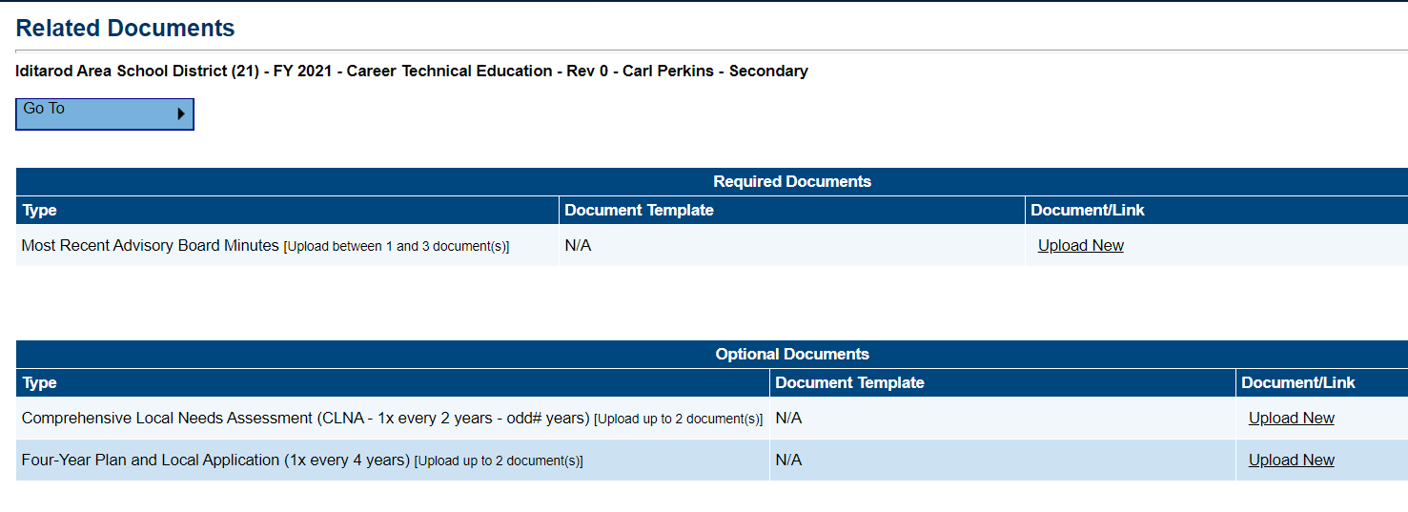
Related Documents
This page allows grantees to upload required documents
Note that there may be more than one type of required document
Under Type header are LIMITS to number of documents allowed
There may be Document Templates here which can be downloaded
If required documents are not uploaded, there will be an ERROR and the grantee will not be able to complete the application

Slide 5
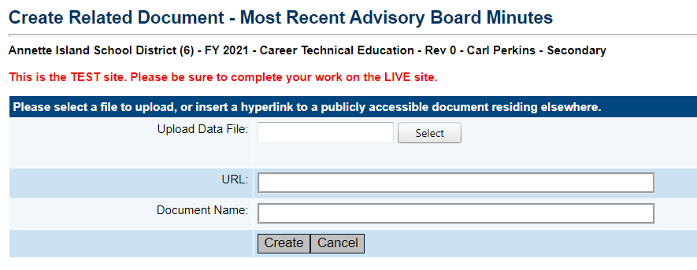
Uploading Related Documents
Upload a file from your computer – standard practice

Slide 6
Uploading Related Documents, cont.
Please NAME and DATE your file – i.e. “Advisory Board Minutes 1/16/2019”
File is then selectable as a link

Slide 7
Contacts Page
IMPORTANT Page! – This is DEED’s contact list
Drop down menu: everyone in the district who can edit the grant
Select district contact who has primary responsibility for entering/managing grant
DEED contact for grant questions
Sent automatic emails from GMS when grant status changes
If dropdown DOES NOT SHOW district’s primary contact name –
Work with district’s User Access Administrator
Get contact added to GMS
DO NOT temporarily select from available names to move on

Slide 8
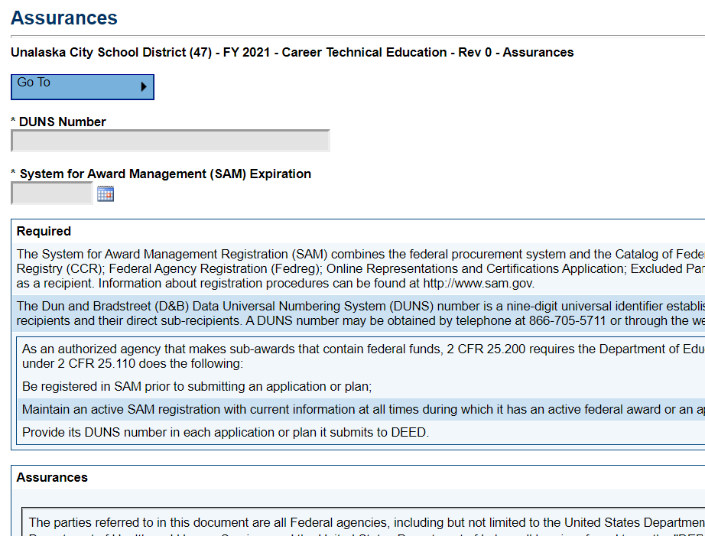
Assurances Page
Assurances that federal requirements will be met
Superintendent must approve the original grant as the responsible party
Instructions for SAM and DUNS are given
SAM/DUNS also located in ESEA Consolidated grant, or from your finance office
Assurances Page must be completed or an error will block grant approval
SAM and DUNS: These are numbers that identify the district as an applicant for federal funds, and connect to the federal procurement system. Complete description at the top of the Perkins Assurances Page.

Slide 9
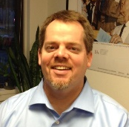
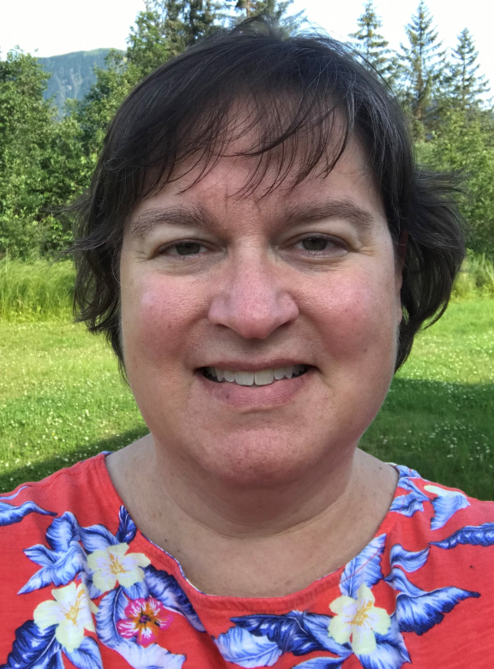
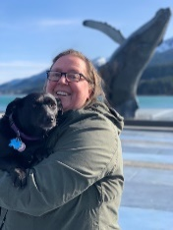
DEED/CTE Team
Deborah Riddle
Division Operations Manager, Innovation & Education Excellence
907-465-2892
deborah.riddle@alaska.gov
Brad Billings
Administrator, Career and Technical Education
907-465-8720
brad.billings@alaska.gov
GMS Specialist
Sheila Box
CTE Program Specialist
907-465-8704
sheila.box@alaska.gov
Felicia Swanson
Education Associate
907-465-2980
felicia.swanson@alaska.gov
Bjørn Wolter
CTE Program Specialist
907-465-6542
Bjorn.wolter@Alaska.gov
Notes:
This is the CTE team.
Contact any of us with CTE questions
Sheila is the GMS specialist on the team – call her with questions specific to GMS

