Slide 1
LEA User Access Administrators
Biannual (2x Per Year) Review
Grantee Users/Roles
Recording Link:
https://stateofalaska.webex.com/stateofalaska/ldr.php?RCID=710eff67ecadca1b4e9e8ed8a5c4af51
LEA User Access Administrator Technical Assistance
Sheila Box - August 24, 2017

Slide 2
Accessing the System
GMS = Grants Management System
https://gms.education.alaska.gov/
Notes:
Going to be EASY because you guys have already been using the budget!
I pinned the web address to my task bar – which I recommend if you will be using GMS often.
All of the listed grants are in here - You can also view handy information in other grants – i.e. student counts in Title I Building Eligibility Spreadsheet
Announcements, Reminders – DEED will put in

Slide 3
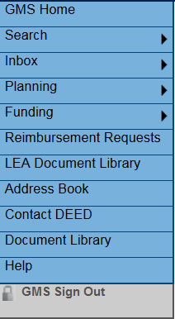
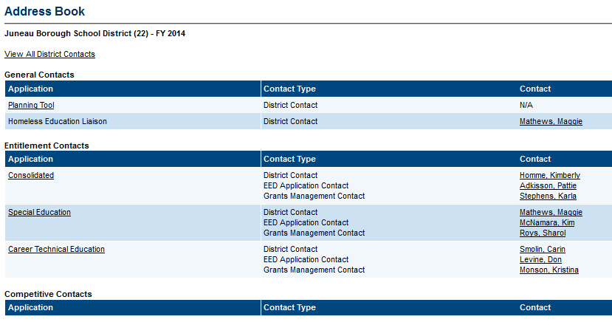
Viewing Users in GMS – Available to All
Address Book – gives a list of the users associated with key roles for each grant. These are the people who will get automatic emails from the system. Underlined things are clickable, click on the name for phone, email
To View all of the Users in a district and their roles in the system, click on View All District Contacts
Notes:
Once signed into a grant
Anyone with a role can view all users for a grant and their roles.
Underlined things are clickable.

Slide 4
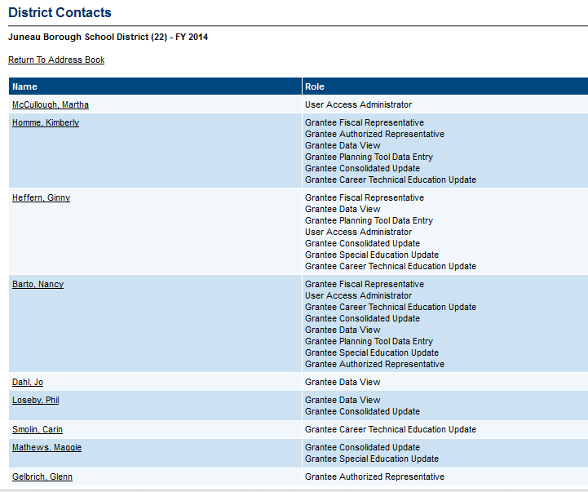
Viewing all Users & Roles
Click on a person’s name, for:
their phone number
fax number
email address
Click on the email address to send an email.
The email will be sent through your computer’s email program, the system does not keep the content of this email.
DEED USES THIS INFORMATION SO PLEASE KEEP IT CURRENT.
Notes:
I find this list most helpful.

Slide 5
User Access Administrator- Responsibilities
Adds / Removes users in the GMS system
Assigns GMS roles for all users in your organization
Maintains records for all GMS users in their organization
Can reset passwords for GMS users who forget them
Makes sure GMS is up to date and correct! (DEED uses this information!)
Notes:
You have the power – the keys to the kingdom!

Slide 6
Managing Users - Maintenance Process
Grantee LEA User Access Administrators are responsible for reviewing all of their users at least 2x annually in GMS.
REMEMBER – There is sensitive information in GMS! Access is just like giving someone keys to your school buildings!
For current employees:
Is there a User Agreement Form signed and dated on file at the Grantees office? See forms in GMS Document Library under All Users & Applications.
Are the roles correct for each employee? Either delete or add roles as necessary.
Is the user no longer employed? If so, make this part of separation protocol:
Delete all roles in the system for the user.
Write “no longer employed,” date and initial on the User Agreement Form when you delete the roles.
Notes:
It is a good idea to ADD roles/passwords to GMS to any intake/separation paperwork you may already use, so that this does not get missed.
Remember – People with access to GMS could change budgets, erase applications, potentially access student information if there is any in GMS.

Slide 7
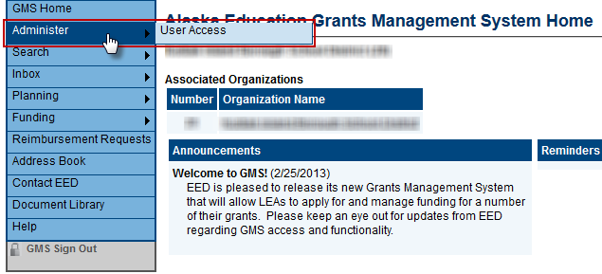
Managing Users
LEA User Access Administrators Only:
Hover on Administer, then User Access from the left hand menu.
Notes:
Next 4 slides just for User Access Administrators – quick, but folks should know what they can do. Anyone who is a User Access Administrator can call me if they have questions.

Slide 8
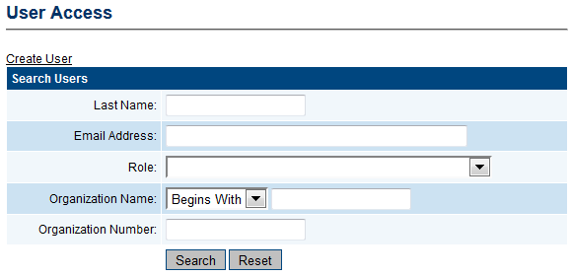
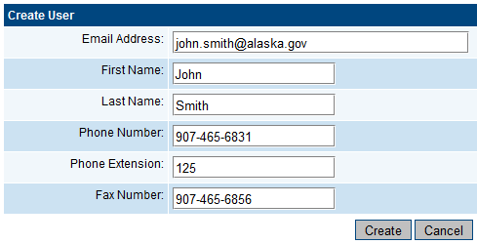
Managing Users – Create User – LEA User Access Admin ONLY
Click “Create User” link
Enter new user’s information
Phone + Extension
Fax Number optional
Click “Create”
Notes:
Can also Search users from this page – last name is easiest. When searching, you don’t have to fill in all the fields. Just select one, and search by it.

Slide 9
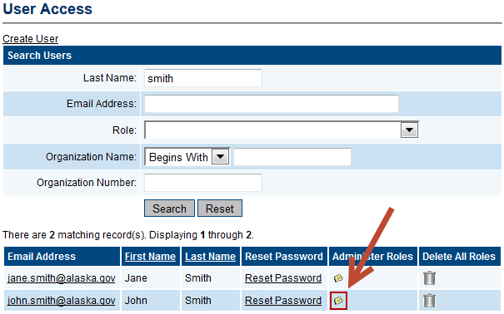
Managing Roles - Existing User – LEA User Access Admin ONLY
Can search for existing user by Last Name, Email, Role, and/or Organization
Make SURE it’s the RIGHT PERSON!!!
Notes:
If you’ve searched for users – List will appear
BE Careful to select the right people!
Garbage can – delete all roles for that person – the person stays in, but with no roles they can only view information.
Select Name to change phone, email, etc.
Select “Administer Roles” to change roles for John Smith

Slide 10
Managing Roles – LEA User Access Admin ONLY
Lists all roles assigned to this user and the organizations those assignments apply to
Can add new or delete existing roles for this user
New user, no roles yet.
Notes:
Will get one of these screens – new user, or if you’ve searched, existing user
either Create a new role, or delete one from this page.
A new user won’t have any roles yet – CREATE ROLE
An existing user will have roles, can delete them one at a time.
Garbage can – again – for deleting one particular role

Slide 11
Managing Roles - Create Role - LEA User Access Admin ONLY
User has now been created but has no roles in the system
Click “Create Role”
Select Role you wish to assign to user – make sure Organization is selected IF it shows up.
CONTRACTORS – If you are working with a contractor – CONTACT DEED to set up their roles – this allows a contractor to use one (1) login for multiple grantees – you cannot do this at the grantee level!
Click “Create”
Notes:
Make sure If any options are given for Organization that you are selecting the right one. This may not happen.
All Roles will show in the second drop down.

Slide 12
Users & Roles
DISTRICT/GRANTEE ROLES
ROLE | DESCRIPTION
User Access Administrator Maintains the Users in the system | Allows a District/Grantee user to administer other users for the District/Grantee. Add new users, assign roles, delete roles, reset passwords. EED must add this user to the system
Grantee (Funding Application) Update Updates the Application, Budget Revisions and Reimbursement Requests for appropriate funding application | Allows a District/Grantee to enter and edit information in the appropriate funding application. More than one user can be assigned this role.
Grantee Date View Allows user to view without making any changes in the system | Allows a District/Grantee user to view unapproved items for the District/Grantee.
Grantee Planning Tool Data Entry Updates Planning Tool within Consolidated Application | Allows a District/Grantee to enter and edit the district plan. The district plan includes goals, strategies, and fiscal resources that can be used for any funding application.
Grantee Fiscal Representative Approves the application, budget revisions and reimbursement requests (most likely the Business Manager) | Allows a District/Grantee to take actions associated with the district business manager. This user must provide approval before submission to the district superintendent or designee.
Grantee Authorized Representative Final Approval of application and revisions (most likely the Superintendent or designee) | Allows a District/Grantee to take actions associated with the district superintendent or designee. This user provides the final approval step for the application or revision to be submitted to EED.
Grantee Superintendent | Allows superintendent or designee name to be printed on Grant Awards.
Do you have a new employee who needs access to GMS?
Complete Grantee User Agreement Form.
Add user to GMS.
Create appropriate roles.
Contractor?
District - contact DEED to setup a User/Role account, so contractors working with multiple districts have only one sign in.
A copy of the GMS roles is located in the Document Library under All Users & Applications, User Access Policy and Forms
Notes:
You may need more than one person in a particular role, but LIMIT where possible – NOT a free-for all! We recommend 2 people per role per district – in case someone is traveling or sick.
System designed to send emails automatically at certain points in the process to key selected people based on their roles and who is the “CONTACT” for each grant.

Slide 13
Workflow
Only one person can control/enter data on a particular page in GMS at a time.
Application is like a volleyball, in control of either the Grantee or DEED for entry depending on status.
Once an application is moved to Draft Completed, others may approve/not approve, but no one can make changes.
Original Grant – must be approved through Authorized Representative (Superintendent).
Revisions (Budget) – only need to be approved through Fiscal Rep at organization.
Notes:
Only one of us controls the grant at a time.

Slide 14
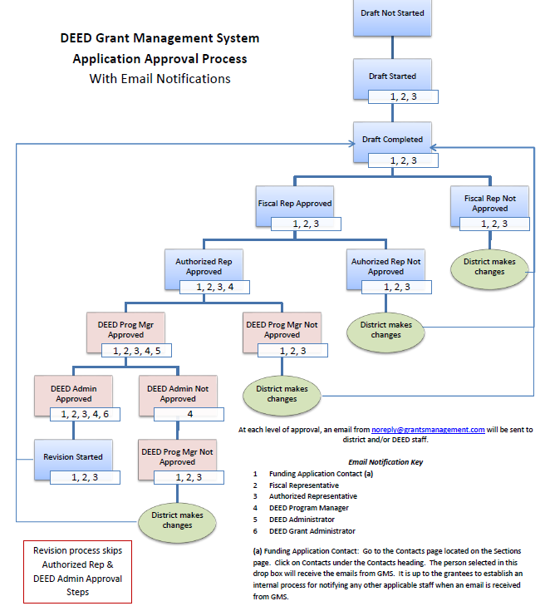
Workflow
Workflow Chart is available in Document Library, System Instructions and Resources, GMS Workflow Process.
Check Junkmail and approve “noreply@egrantsmanagement.com”
Notes:
This chart also tells you who gets emails at each step of the grant – these come from the system.
Make sure you are receiving these emails.

Slide 15
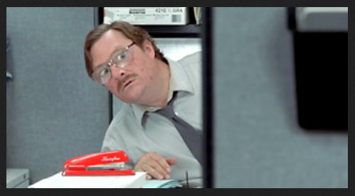
FOR ASSISTANCE WITH ADDING USERS & ADMINISTERING ROLES
Sheila Box (907) 465-8704 sheila.box@alaska.gov
Sharol Roys (907) 465-8694 sharol.roys@alaska.gov

