Slide 1
Grants Management System (GMS)
Training Module 6
MODULE
6
Reviewing Old Applications
Document Library
History Log/Comments
Email
Troubleshooting
Notes:
Module 6 explores more of the extra functions GMS provides, including the ability to review old applications, all of the supports stored in the document library, and the ability to review the history of applications. The ability to email from GMS is covered.
Finally some troubleshooting is covered.

Slide 2
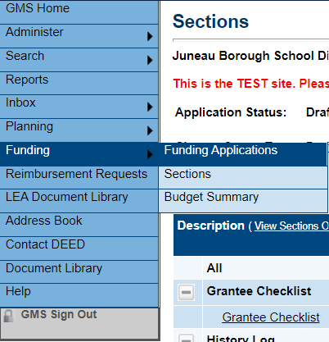
Funding Applications Page
All applications created in GMS since 2014 are available
On the static menu bar, mouse over Funding
This sub-menu accesses:
Funding Applications Page
Sections Page
Budget Summary Page

Slide 3
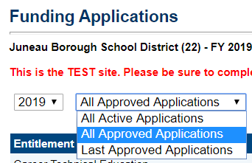
Funding Applications Page, cont.
Year
All Approved – Shows all – including original and all revisions for that year, and current status/date for each
All Active – Shows only current active – not closed applications or previously approved
Last Approved – Shows the last approved original or revision for each grant

Slide 4
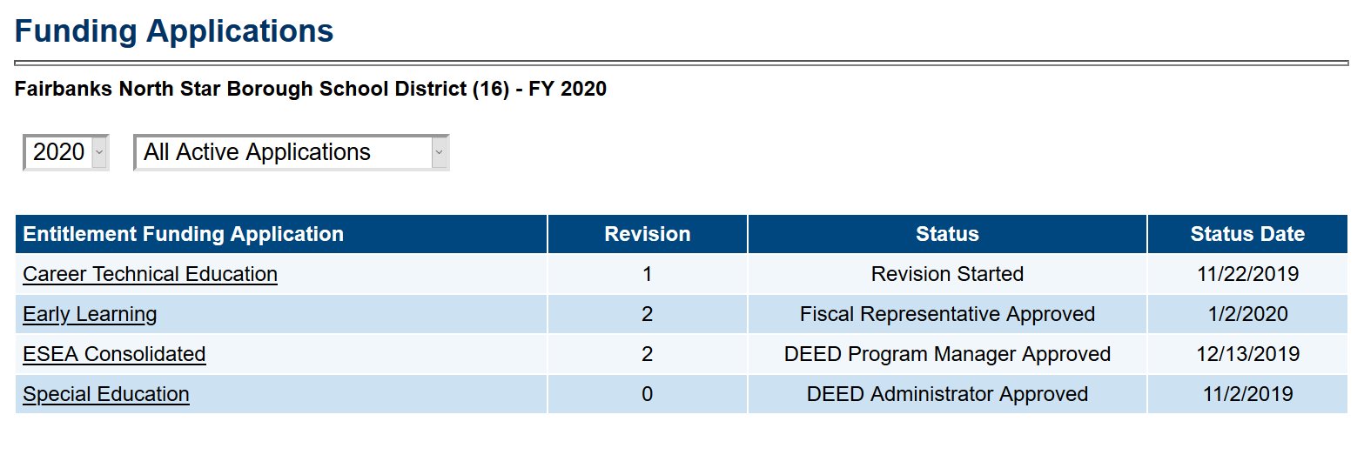
Review Old Applications
Choose year from the Drop Down Box
Choose All Approved Applications
Click on the CTE funding Application

Slide 5
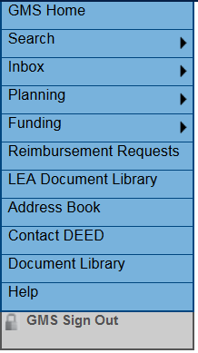
Document Library
Access from the Static Menu Bar – TWO Document Libraries –
LEA Document Library
Document Library
LEA Document Library
District documents from DEED – i.e. 15% carryover waiver letters
Document Library
DEED places documents for your use, including
Forms
Templates
Guidance
Annual workshop presentations/documents
Web links

Slide 6
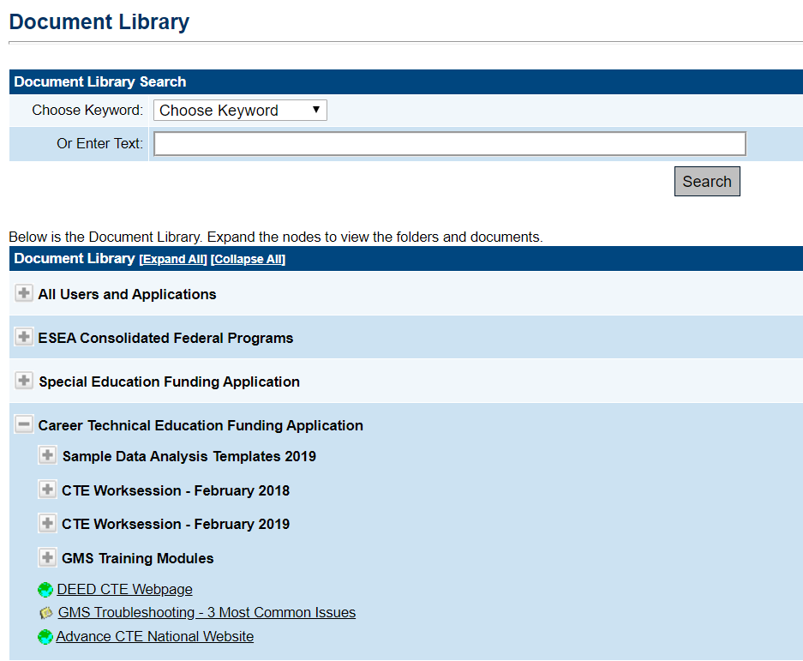
Document Library, cont.
Searchable by Keyword or Text
Most applications have their own sections
A “+” sign indicates sub-folders
Blue globe indicates web link
Yellow folder indicates document

Slide 7
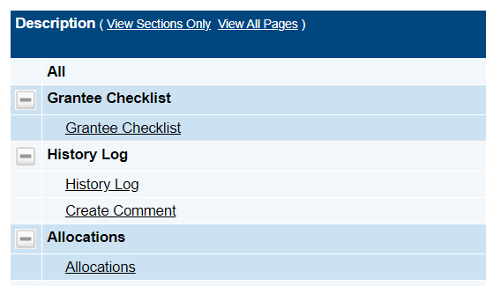
History Log / Create Comment
Select History Log to view system actions and comments for the grant
Select Create Comment to add comment to history log
Comments are Public once a grant is approved
Comments are not delivered to other GMS users unless specified on the Create Comment Page
Comments cannot be deleted
Notes:
History Log – is about the process (when the status changed, who approved an application) and saves comments forever.
Grantee Checklist – is a one-time back and forth for DEED to help communicate with districts the changes needed in each section to approve an application/revision.

Slide 8
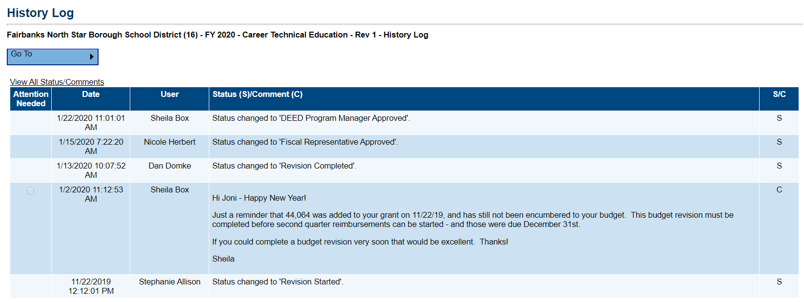
History Log
Current view is the history for the current revision
Select View All Status/Comments to view entire history
Automatic system status changes and comments input by users show here
Sorted by Date
The user who enters a comment may select the box for Attention Needed which pins it to the top of the list

Slide 9
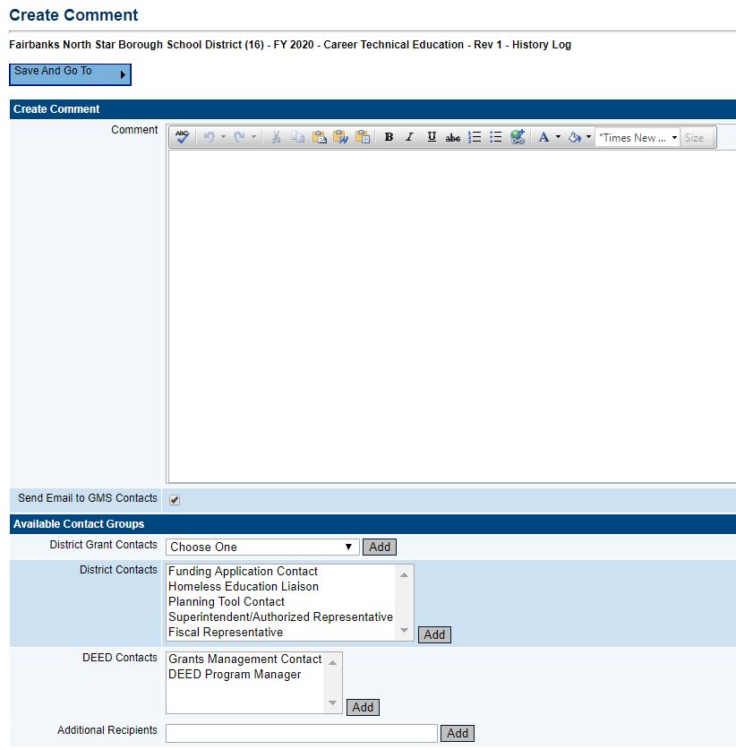
Create Comment Page
Remember all comments are PUBLIC
Select Send Email to GMS Contacts to send comment via email
Select from GMS users, or add additional recipients
Moving away from this page with Save And Go To button saves comment and sends email
GMS does not have a ‘sent email’ box – cc yourself to save a copy

Slide 10
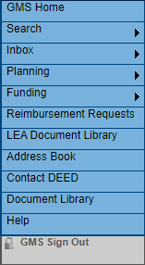
Email Inbox
Select Inbox to view the Email Message Archive page
This page shows emails received by others and GMS
The Drop down box allows for several date ranges
Each message under From or To that is underlined may be selected to expand details

Slide 11
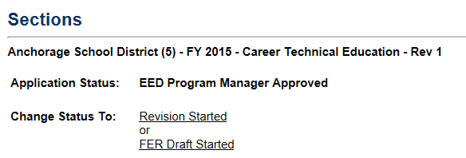
Troubleshooting in GMS
I can’t enter….
It won’t let me…
All my boxes are gray……!!
Stop Clicking! (No, really - - - stop clicking…...)
Can’t sign in? Check with your User Access Administrator for a new password, or to make sure you have the access you need.
Check the STATUS of the application. Does status match your role? If entries cannot be made, it is usually a status/role problem. Look on the Sections Page, at the top for the status.
Are there ERRORS preventing a status change? Go to the Sections Page – look in the Validations column (far right) for Messages
Still Stuck? Call Me! Sheila Box 465-8704

Slide 12
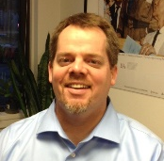
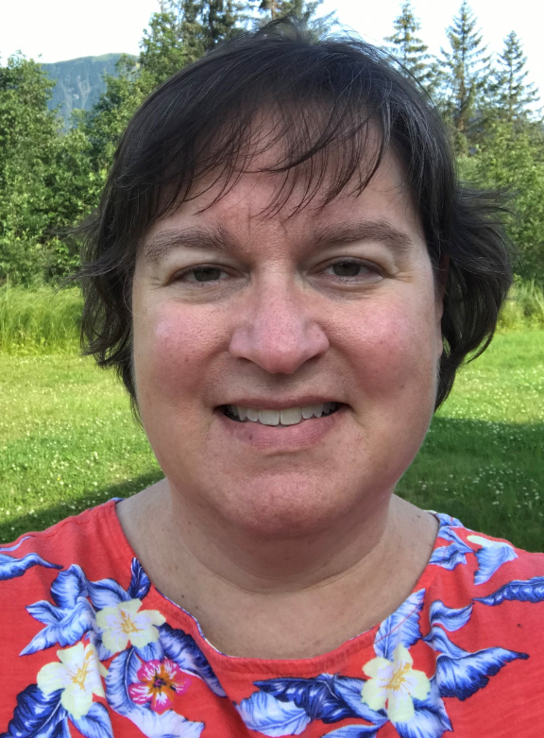
DEED/CTE Team
Deborah Riddle
Division Operations Manager, Innovation & Education Excellence
907-465-2892
deborah.riddle@alaska.gov
Brad Billings
Administrator, Career and Technical Education
907-465-8720
brad.billings@alaska.gov
GMS Specialist
Sheila Box
CTE Program Specialist
907-465-8704
sheila.box@alaska.gov
Felicia Swanson
Education Associate
907-465-2980
felicia.swanson@alaska.gov
Bjørn Wolter
CTE Program Specialist
907-465-6542
Bjorn.wolter@Alaska.gov
Notes:
This is the CTE team.
Contact any of us with CTE questions
Sheila is the GMS specialist on the team – call her with questions specific to GMS

