Slide 1
Grants Management System (GMS)
Training Module 2
Static Menu Bar
Moving Between Grant Pages
Check Boxes/Text Bar Tools
Must Fill Items
Drop Downs
Calendars
MODULE
2
Notes:
Module 2 covers the basics of where things are in GMS, how to move around, and what kinds of icons and prompts are used for the different items collected within grants.

Slide 2
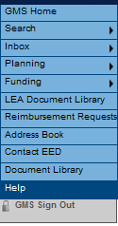
Static Menu Bar
Menus: Items with a triangle mean there are more menus underneath – roll over to reveal the sub-menus
Inbox: Check here for any funding applications or reimbursement requests waiting for approval
Funding: Central link for all funding applications in the system. SECTIONS Page link can also always be found here
LEA Document Library: For letters and notices from DEED, i.e. 15% Carryover waiver approval
Document Library: A huge repository of grant-related information provided by DEED
Address Book: Provides a list of DEED and District Contacts for all funding applications
Notes:
The static menu bar (medium blue, upper left) is on every page you view in GMS.
There is a lot of information here – it’s worth ‘poking around’ in the menus to familiarize yourself.

Slide 3
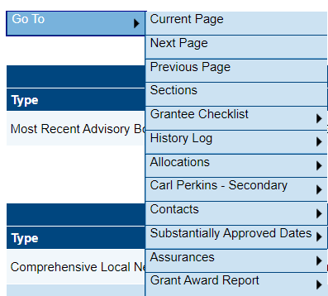
Moving Between Pages
Every page EXCEPT the Sections page has either a Go To or a Save And Go To button at the top and the bottom. Use these to navigate to another page, which also saves your work. (keyboard or browser ‘Back’ buttons will NOT work in GMS)
Roll the mouse over to open the sub-menu.
First level static options - current/next/previous/sections
First level ‘chapters’ - identical the Sections page.
Submenus are Section ‘pages’ – identical to the pages under ‘chapters’ on the Sections page.

Slide 4
Check Boxes / Text Box Tools / Must Fill
Check boxes in GMS are TINY. Watch for them. They toggle on and off.
When you see a tiny ASTERISK * by an item, it is a MUST FILL. GMS issues an error message and will not complete the application if this box is not filled.

Slide 5
Text Box Tools
Text boxes in GMS come with a standard Word toolbar.
You may change the size and color of text.
You can Bold, Italicize, Underline, or strike through
You may choose from nine fonts
You may use numbered or bulleted lists
Copy/Paste in GMS goes through 3 clipboard icons, instead of direct to the text box

Slide 6
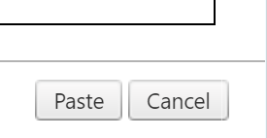
Text Boxes – Copy/Paste
Select text to be copied.
In GMS text box, select the clipboard icon matching intent of copied text –
No location specified – notepad, etc. No formatting will copy
Word document – most complex, most formatting will copy
Plain text – strips out all formatting from original
In the resulting popup box, use Ctrl+V to Paste. (Cmd+V on Mac)
Select the Paste button at the bottom of the popup box.

Slide 7
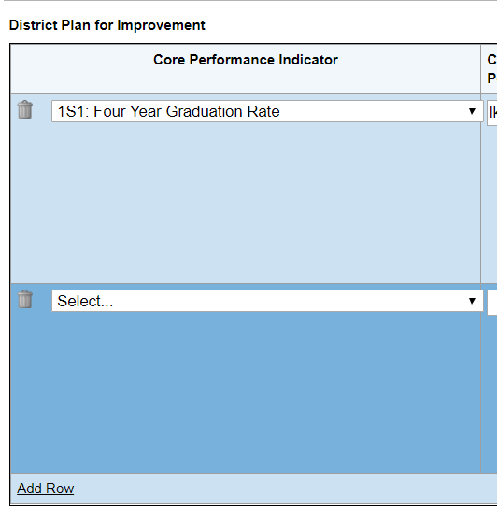
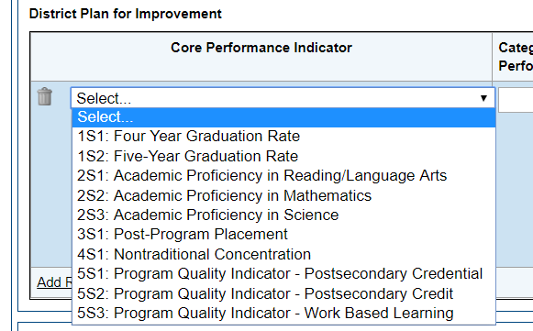
Drop Downs / Add Row / Delete
There are many places GMS uses drop-down menus
There may also be an Add Row option, underlined things are clickable
The Garbage Can means Delete that item or row
Notes:
The first few times through GMS, go slow and notice all the icons associated with each box or item to be filled. Most icons are intuitive.
Speeding through an application means possible missing some.

Slide 8
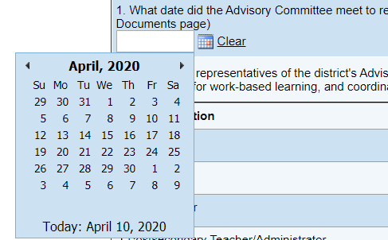
Calendar Buttons
There are several places in GMS where there is a calendar icon button
Selecting this button opens a calendar, like most online calendar buttons (Alaska Airlines)
Once a date is selected, use Clear to delete it and start over
Notes:
If a date already exists that needs to be changed, use Clear to delete it and start over

Slide 9
DEED/CTE Team
Deborah Riddle
Division Operations Manager, Innovation & Education Excellence
907-465-2892
deborah.riddle@alaska.gov
Brad Billings
Administrator, Career and Technical Education
907-465-8720
brad.billings@alaska.gov
GMS Specialist
Sheila Box
CTE Program Specialist
907-465-8704
sheila.box@alaska.gov
Felicia Swanson
Education Associate
907-465-2980
felicia.swanson@alaska.gov
Bjørn Wolter
CTE Program Specialist
907-465-6542
Bjorn.wolter@Alaska.gov
Notes:
Contact any of us with CTE questions
Sheila is the GMS specialist on the team – call her with questions specific to GMS

