Slide 1
Upcoming Grant Funding Opportunities Strengthening Career and Technical Education for the 21st Century Act (Perkins V)
Alaska Department of Education & Early Development
September 29, 2021
RECORDING LINK:
https://us02web.zoom.us/rec/share/MkuG5QnipuFSyYj7s8vBlDA9Y2CnSSL_nvr6baAPazxK5ZdIHj2GbS_XlKQ9Pl6S.1o6xql3ZCVfH-q1m
Notes:
Every DEED presentation should start with this title slide. Adjust presenter(s) names as appropriate.

Slide 2
Our Mission and Vision

Slide 3
Alaska’s Ed Challenge 5 Trajectories:
Early reading
Increase career, technical, and culturally relevant education to meet student and workforce needs.
Equitable educational rigor
Effective teachers
Safety and well-being

Slide 4
Agenda
Overview of grant programs:
Professional Development Grants
Non-Traditional Occupations Grants
Postsecondary Grants
Advice from a current grantee
Question & Answers

Slide 5
Grant Programs

Slide 6
Professional Development
Notes:
Grants to provide high-quality, in-demand professional development in either content or pedagogical skills
PD may take many different forms—Intensive camps or field courses, semester-based classes, seminars, or…?
Targeted at both school districts and postsecondary institutions
(In a new development, we will be making all grant payments in bitcoin while listening to Pink Floyd’s “Time” on an endless loop…)
Awards of up to $25,000
Grant term is one year (FY22)—All activities must be completed no later than June 30, 2022
Reporting requirements —> An end-of-grant report is due by July 15, 2022. This must detail:
If grant objectives were achieved;
Documentation of success;
Challenges encountered;
Improvements suggested;
The number of teachers and district served; and
A final budget summary
Grant proposals are due by 4:00pm on October 15, 2021.

Slide 7
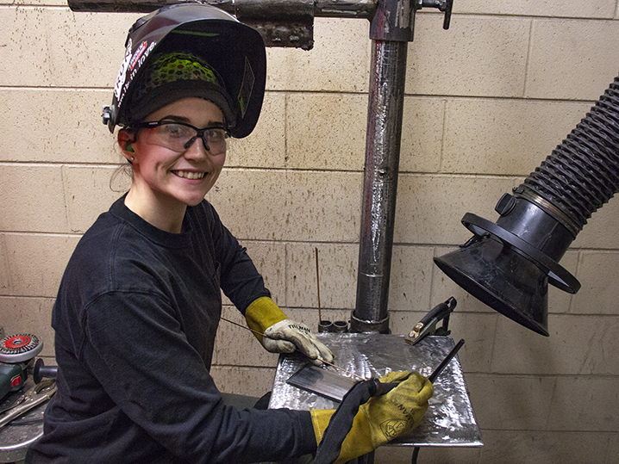
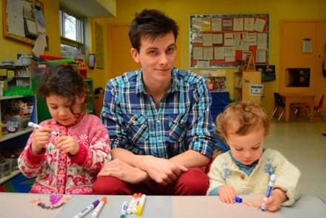
Non-Traditional Occupations
Notes:
Grants to expand access to high-quality CTE instruction in careers with disproportionate gender representation where individuals from one gender comprise less than 25% of individuals employed in that field
Women in manufacturing, engineering, STEM, agriculture, etc.
Men in education, early childhood development, book-keeping, nursing, etc.
May focus on one intervention for a single gender, multiple intervention strategies, or on increasing participation for genders in under-represented fields
This grant is for school districts (LEAs)
Awards of up to $20,000/yr
DEED/CTE expects to make three awards for the next grant cycle
Grant term is three years (FY23, FY24, and FY25)
Proposals are due by 4:00pm on April 15, 2022

Slide 8
Postsecondary
Notes:
Focus of this program is to:
Provide secondary CTE students access to dual-credit opportunities in high-needs occupations; or
Provide professional development of CTE instructors
This grant is for any postsecondary institution
Grants should target instruction or PD in one of nine priority workforce development areas:
Maritime
Tourism & Hospitality
Healthcare
Oil & Gas
Construction
Mining
Education
Information Technology
Entrepreneurship
Maximum award size of $150,000/yr
DEED/CTE expects to make up to five to six awards for the next grant cycle—total annual allocation not to exceed $450,000 per year
Grant term is three years (FY23, FY24, and FY25)
If selected for award, a current comprehensive needs assessment will be required no later than July 1, 2022
Proposals are due by 4:00pm on April 15, 2022

Slide 9
Advice from Fairbanks NorthStar Borough School District
Joni Simpson

Slide 10
Questions?

