Slide 1
Grants Management System (GMS) Training Module 7
MODULE
7
Tagging and Filtering Budget Items
Notes:
Module 7 covers the NEW (as of FY21) process of tagging budget items to link them to the Comprehensive Local Needs Assessment (CLNA) that districts must complete or update every 2 years.

Slide 2
Why ‘Tag’ Budget Items?
It’s Required – under Perkins V all budget items must be driven by the Comprehensive Local Needs Assessment (CLNA)
DEED identified five “Parts” of the CLNA to act as “Tags” for budget items
Part A – Student Performance
Part B – Program Quality
Part C – CTE Programs and Programs of Study (CTEPS)
Part D – Recruitment, Retention, and Training of CTE Educators
Part E – Equity and Access

Slide 3
Tags Strengthen Connections
The five “Parts” A-E are consistent throughout the entire Perkins Process in Alaska.
Budget tags associated with the five “Parts” A-E are a simple way to ensure that the items in the annual budget reflect:
Needs identified by the CLNA as priorities
Planning for those priority needs in the Four-Year Plan and Local Application
Expenditures are tied to the identified needs the district has planned for

Slide 4
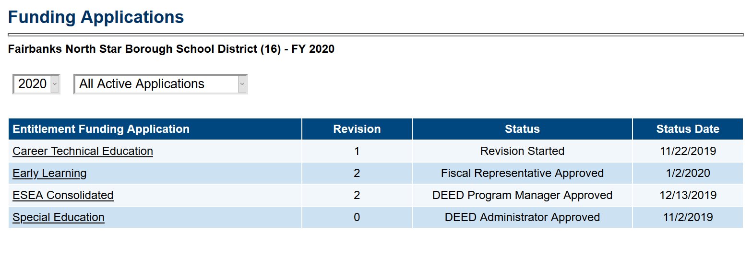
Review Last CLNA or Application
Choose year from the Drop Down Box
Choose Approved Applications
Click on the CTE funding Application
*Use this process to find old CLNA or Four- Year Plan and Local Application Documents
Notes:
Remember that the Annual Update in GMS is just that – an update to the actual application – which is the Four-Year Plan and Local Application document.
These can be found on the Related Documents Page in GMS

Slide 5
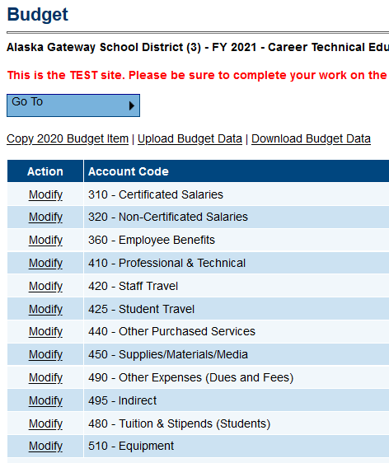
GMS Budget - NEW
Grant Must be in Draft Started or Revision Started Status
Options:
COPY (1x only – see Module 2 or below)
Work directly in GMS as usual
Use Excel to upload /download budgets
COPY – must be chosen before entering any budget info - 1st time or it will disappear
Notes:
Your grant will need to be in Draft Started or Revision Started in order to see MODIFY
UPLOAD/DOWNLOAD – uses EXCEL

Slide 6
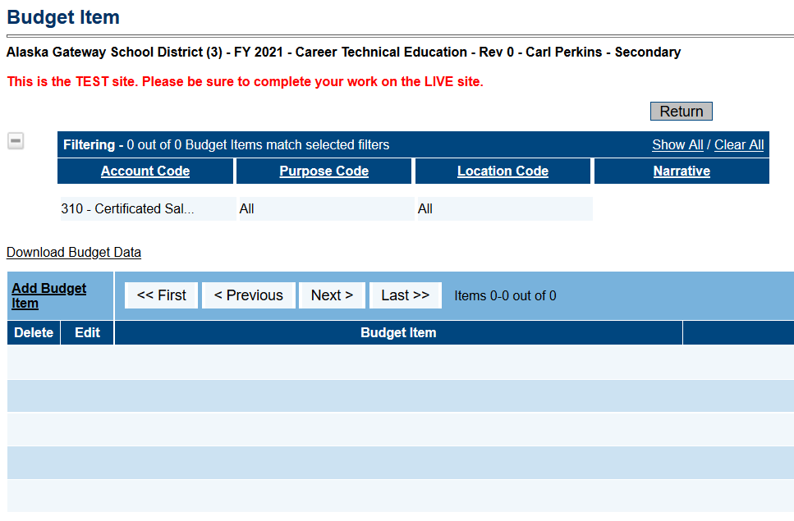
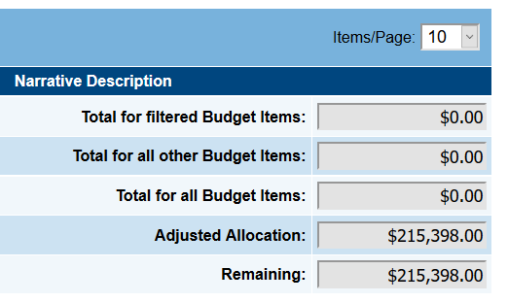
GMS Budget – NEW Detail
The Budget Item page allows for filtering at the top
Filtered items are totaled separately
Notes:
Main page – allows you to Add items
Filter items
Shows Filtered Total on the Right hand side

Slide 7
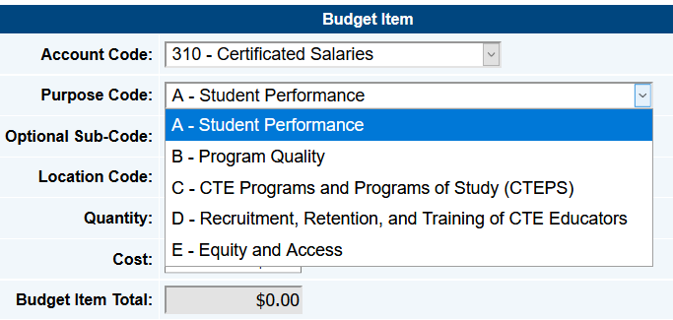
Create Budget Item - Budget Codes
Purpose Code:
One of the Five “Parts” that must match an identified need from the CLNA, and the plan for that need in the Four-Year Plan and Local Application document.

Slide 8
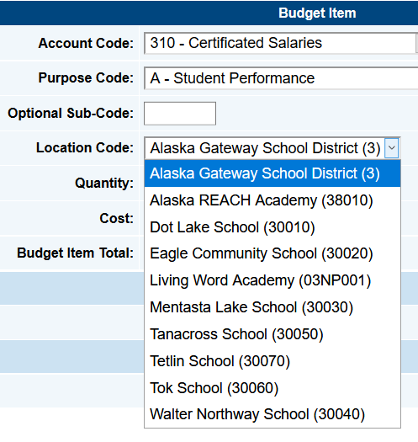
Create Budget Item - Budget Codes, cont.
Create each new budget item using appropriate codes
Optional Sub-Code - if district has extra coding – must continue for reimbursements if used
Location Code – if district wishes to track budget by school (default is District)
Notes:
It will be worth considering how the district would like to track expenditures

Slide 9
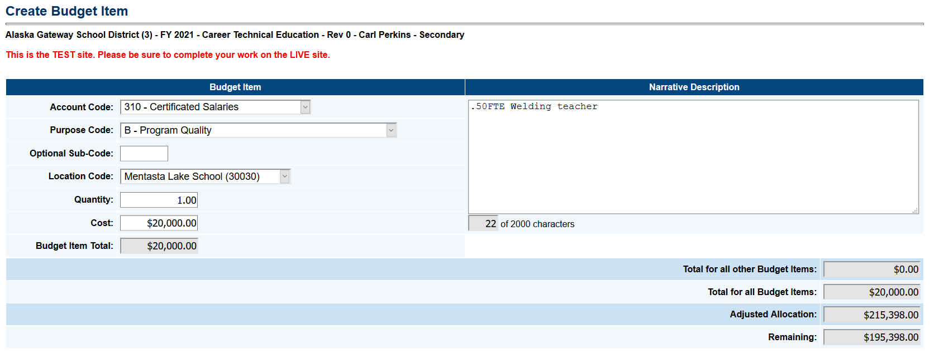
New Budget Item
Complete budget items will have:
Account Code
Purpose Code
Location Code
Quantity/Cost
Narrative – must be tied to approved course

Slide 10
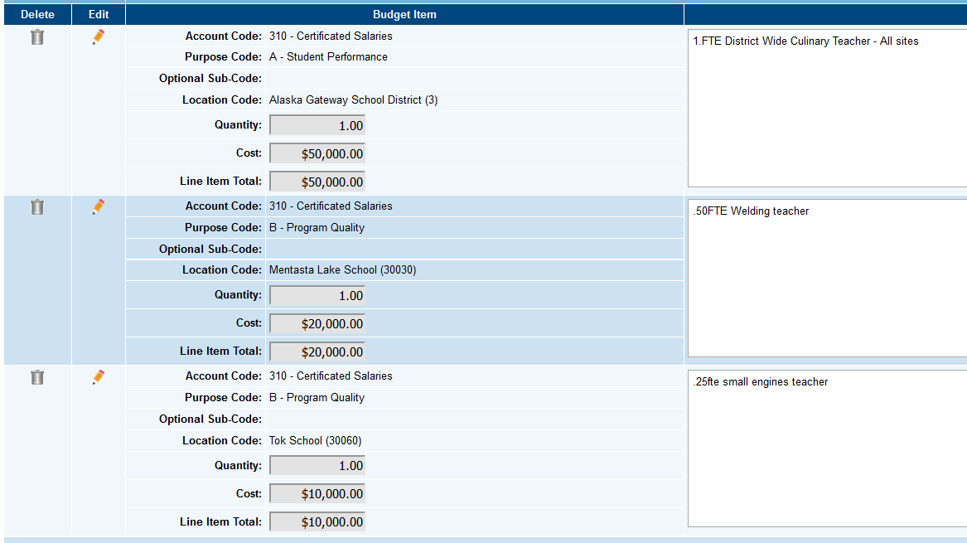
New Budget Items – Modify
In Modify – Budget items view
Each item shows ‘tags’
Each item shows narrative
Items may be deleted here
Items may be edited here
Notes:
Edit and Delete Options – pencil and trash can
Modify view - lists all items showing all the details

Slide 11
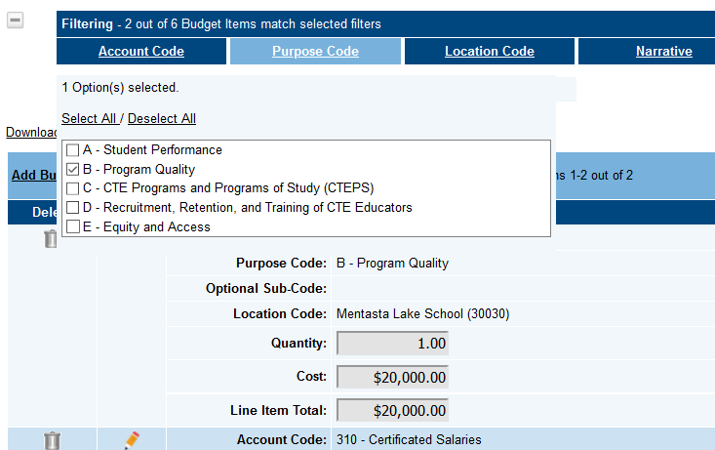
Filtering ‘Tags’
Filter – 4 Columns at the top
Select one or multiple items under each column
Use to look at one school
Use to look at all staff costs
Notes:
You could select all tags for a particular school if you are having schools send expenditures to you in Excel budgets (which you can UPLOAD)
You could select all supplies for the Part B - Program Quality Purpose Code
Lots of ways to use this feature

Slide 12
Filtered List
Items/Page – you may increase the number of filtered items that will show on the page if you need to
Notes:
A Filtered list will show your selected items, and the Indirect associated with them
Items/Page - option on the Right hand side at the top of the list to increase items shown on each page – scroll down
You may DOWNLOAD BY FILTERED LIST if you like

Slide 13
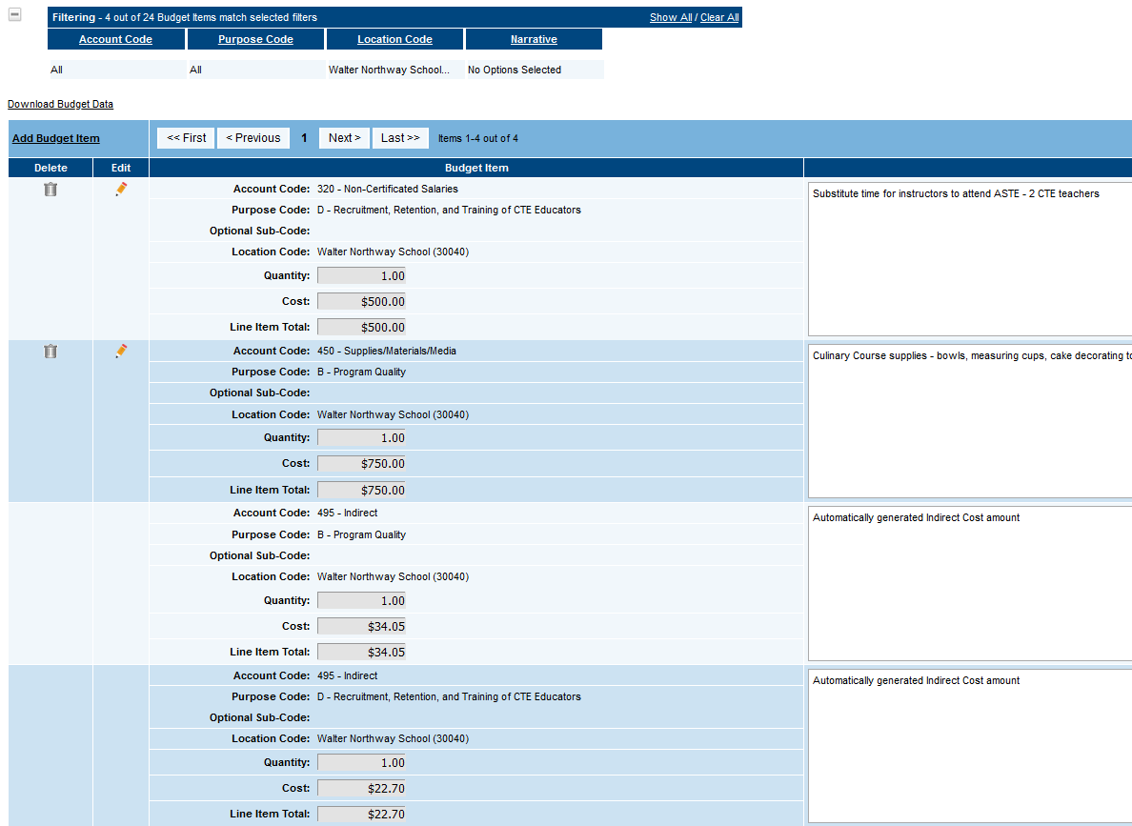
Filtered List – One School
All Walter Northway School
Includes multiple:
Account Codes
Purpose Codes
This filtered budget may be DOWNLOADED to district files
Notes:
Schools can send you their budgets, which can be uploaded
You can track these by downloading budgets by school
You may DOWNLOAD BY FILTERED LIST if you like

Slide 14
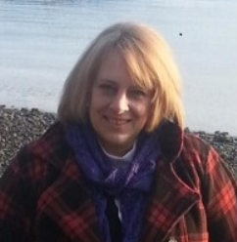
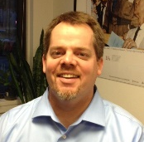
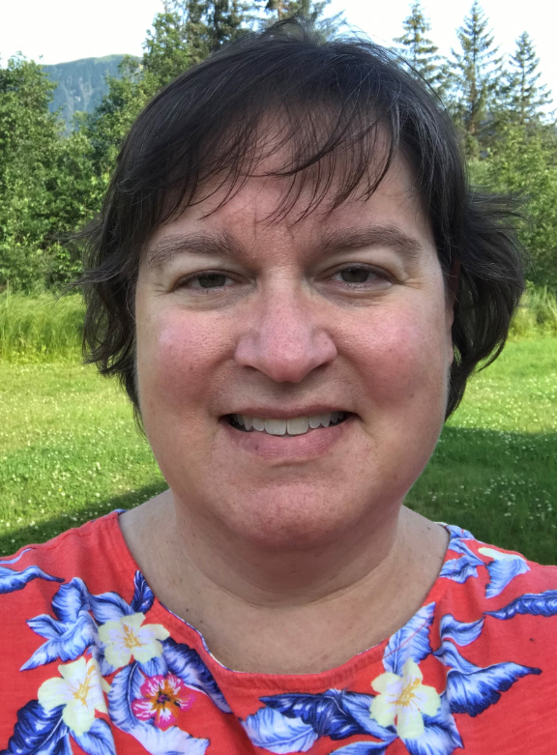
DEED/CTE Team
Deborah Riddle
Division Operations Manager, Innovation & Education Excellence
907-465-2892
deborah.riddle@alaska.gov
Brad Billings
Administrator, Career and Technical Education
907-465-8720
brad.billings@alaska.gov
GMS Specialist
Sheila Box
CTE Program Specialist
907-465-8704
sheila.box@alaska.gov
Felicia Swanson
Education Associate
907-465-2980
felicia.swanson@alaska.gov
Bjørn Wolter
CTE Program Specialist
907-465-6542
Bjorn.wolter@Alaska.gov
Notes:
This is the CTE team.
Contact any of us with CTE questions
Sheila is the GMS specialist on the team – call her with questions specific to GMS

